Slide 1
PROPERTY, PLANT, AND EQUIPMENT
Property, plant, and equipment are assets of a durable nature. Other terms commonly used are plant assets and fixed assets.
“Used in operations” and not for resale.
Long-term in nature and usually depreciated.
Possess physical substance.
Includes:
Land,
Building structures (offices, factories, warehouses), and
Equipment (machinery, furniture, tools).
LO 1

Slide 2
10
Acquisition and Disposition of Property, Plant, and Equipment
LEARNING OBJECTIVES
After studying this chapter, you should be able to:
Describe property, plant, and equipment.
Identify the costs to include in initial valuation of property, plant, and equipment.
Describe the accounting problems associated with self-constructed assets.
Describe the accounting problems associated with interest capitalization.
Understand accounting issues related to acquiring and valuing plant assets.
Describe the accounting treatment for costs subsequent to acquisition.
Describe the accounting treatment for the disposal of property, plant, and equipment.

Slide 3
ACQUISITION OF PROPERTY, PLANT, AND EQUIPMENT (PP&E)
Historical cost measures the cash or cash equivalent price of obtaining the asset and bringing it to the location and condition necessary for its intended use.
In general, costs include:
Purchase price, including import duties and non-refundable purchase taxes, less trade discounts and rebates.
Costs attributable to bringing the asset to the location and condition necessary for it to be used in a manner intended by the company.
LO 2

Slide 4
ACQUISITION OF PROPERTY, PLANT, AND EQUIPMENT (PP&E)
Companies value property, plant, and equipment in subsequent periods using either the
cost method or
fair value (revaluation) method.
LO 2

Slide 5
ACQUISITION OF PP&E
Cost of Land
All expenditures made to acquire land and ready it for use. Costs typically include:
purchase price;
closing costs, such as title to the land, attorney’s fees, and recording fees;
costs of grading, filling, draining, and clearing;
assumption of any liens, mortgages, or encumbrances on the property; and
additional land improvements that have an indefinite life.
LO 2

Slide 6
ACQUISITION OF PP&E
Cost of Land
Improvements with limited lives, such as private driveways, walks, fences, and parking lots, are recorded as Land Improvements and depreciated.
Land acquired and held for speculation is classified as an investment.
Land held by a real estate concern for resale should be classified as inventory.
LO 2

Slide 7
ACQUISITION OF PP&E
Cost of Buildings
Includes all expenditures related directly to acquisition or construction. Costs include:
materials, labor, and overhead costs incurred during construction and
professional fees and building permits.
Companies consider all costs incurred, from excavation to completion, as part of the building costs.
LO 2

Slide 8
ACQUISITION OF PP&E
Cost of Equipment
Include all expenditures incurred in acquiring the equipment and preparing it for use. Costs include:
purchase price,
freight and handling charges,
insurance on the equipment while in transit,
cost of special foundations if required,
assembling and installation costs, and
costs of conducting trial runs.
LO 2

Slide 9
VALUATION OF PROPERTY, PLANT & EQUIPMENT
Companies should record property, plant, and equipment:
at the fair value of what they give up or
at the fair value of the asset received,
whichever is more clearly evident.
LO 5

Slide 10
VALUATION OF PP&E
Cash Discounts — Discounts for prompt payment.
Deferred-Payment Contracts — Assets purchased on long-term credit contracts are valued at the present value of the consideration exchanged.
Lump-Sum Purchases — Allocate the total cost among the various assets on the basis of their relative fair market values.
Issuance of Shares — The market price of the shares issued is a fair indication of the cost of the property acquired.
LO 5

Slide 11
VALUATION OF PP&E
Exchanges of Non-Monetary Assets
Ordinarily accounted for on the basis of:
the fair value of the asset given up or
the fair value of the asset received,
whichever is clearly more evident.
Companies should recognize immediately any gains or losses on the exchange when the transaction has commercial substance.
LO 5

Slide 12
Exchanges of Non-Monetary Assets
Meaning of Commercial Substance
Exchange has commercial substance if the future cash flows change as a result of the transaction. That is, if the two parties’ economic positions change, the transaction has commercial substance.
ILLUSTRATION 10-10
Accounting for Exchanges
LO 5

Slide 13
Exchanges of Non-Monetary Assets
Exchanges—Loss Situation
Companies recognize a loss immediately whether the exchange has commercial substance or not.
Rationale: Companies should not value assets at more than their cash equivalent price; if the loss were deferred, assets would be overstated.
LO 5

Slide 14
Exchanges of Non-Monetary Assets
Illustration: Information Processing, Inc. trades its used machine for a new model at Jerrod Business Solutions Inc. The exchange has commercial substance. The used machine has a book value of €8,000 (original cost €12,000 less €4,000 accumulated depreciation) and a fair value of €6,000. The new model lists for €16,000. Jerrod gives Information Processing a trade-in allowance of €9,000 for the used machine. Information Processing computes the cost of the new asset as follows.
ILLUSTRATION 10-11
Computation of Cost of
New Machine
LO 5

Slide 15
Exchanges of Non-Monetary Assets
Illustration: Information Processing records this transaction as follows:
Equipment 13,000
Accumulated Depreciation—Equipment 4,000
Loss on Disposal of Equipment 2,000
Equipment 12,000
Cash 7,000
ILLUSTRATION 10-12
Computation of Loss
on Disposal of Used
Machine
Loss on Disposal
LO 5

Slide 16
Exchanges of Non-Monetary Assets
Exchanges—Gain Situation
Has Commercial Substance. Company usually records the cost of a non-monetary asset acquired in exchange for another non-monetary asset at the fair value of the asset given up, and immediately recognizes a gain.
LO 5

Slide 17
Exchanges of Non-Monetary Assets
Illustration: Interstate Transportation Company exchanged a number of used trucks plus cash for a semi-truck. The used trucks have a combined book value of $42,000 (cost $64,000 less $22,000 accumulated depreciation). Interstate’s purchasing agent, experienced in the secondhand market, indicates that the used trucks have a fair market value of $49,000. In addition to the trucks, Interstate must pay $11,000 cash for the semi-truck. Interstate computes the cost of the semi-truck as follows.
Illustration 10-13
Computation of Semi-Truck Cost
LO 5

Slide 18
Exchanges of Non-Monetary Assets
Illustration: Interstate records the exchange transaction as follows:
Truck (semi) 60,000
Accumulated Depreciation—Trucks 22,000
Trucks (used) 64,000
Gain on Disposal of Trucks 7,000
Cash 11,000
ILLUSTRATION 10-14
Computation of Gain on Disposal of Used Trucks
Gain on Disposal
LO 5

Slide 19
Exchanges of Non-Monetary Assets
Exchanges—Gain Situation
Lacks Commercial Substance. Now assume that Interstate Transportation Company exchange lacks commercial substance.
Interstate defers the gain of $7,000 and reduces the basis of the semi-truck.
LO 5

Slide 20
Exchanges of Non-Monetary Assets
Illustration: Interstate records the exchange transaction as follows:
Trucks (semi) 53,000
Accumulated Depreciation—Trucks 22,000
Trucks (used) 64,000
Cash 11,000
ILLUSTRATION 10-15
Basis of Semi-Truck—
Fair Value vs. Book Value
LO 5

Slide 21
Exchanges of Non-Monetary Assets
Summary of Gain and Loss Recognition on Exchanges of Non-Monetary Assets
ILLUSTRATION 10-16
Disclosure include
nature of the transaction(s),
method of accounting for the assets exchanged, and
gains or losses recognized on the exchanges.
LO 5

Slide 22
VALUATION OF PP&E
Government Grants
Government Grants are assistance received from a government in the form of transfers of resources to a company in return for past or future compliance with certain conditions relating to the operating activities of the company.
IFRS requires grants to be recognized in income (income approach) on a systematic basis that matches them with the related costs that they are intended to compensate.
LO 5

Slide 23
Government Grants
Example 1: Grant for Lab Equipment. AG Company received a €500,000 subsidy from the government to purchase lab equipment on January 2, 2015. The lab equipment cost is €2,000,000, has a useful life of five years, and is depreciated on the straight-line basis.
IFRS allows AG to record this grant in one of two ways:
Credit Deferred Grant Revenue for the subsidy and amortize the deferred grant revenue over the five-year period.
Credit the lab equipment for the subsidy and depreciate this amount over the five-year period.
LO 5

Slide 24
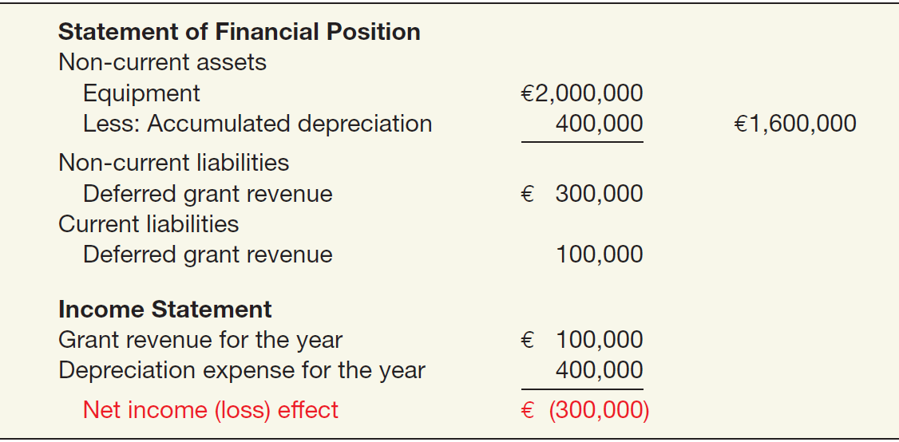
Government Grants
Example 1: Grant for Lab Equipment. If AG chooses to record deferred revenue of €500,000, it amortizes this amount over the five-year period to income (€100,000 per year). The effects on the financial statements at December 31, 2015, are:
ILLUSTRATION 10-17
Government Grant
Recorded as Deferred
Revenue
LO 5

Slide 25
Government Grants
Example 1: Grant for Lab Equipment. If AG chooses to reduce the cost of the lab equipment, AG reports the equipment at €1,500,000 (€2,000,000 - €500,000) and depreciates this amount over the five-year period. The effects on the financial statements at December 31, 2015, are:
ILLUSTRATION 10-18
Government Grant Adjusted to Asset
LO 5

Slide 26
10
Acquisition and Disposition of Property, Plant, and Equipment
LEARNING OBJECTIVES
After studying this chapter, you should be able to:
Describe property, plant, and equipment.
Identify the costs to include in initial valuation of property, plant, and equipment.
Describe the accounting problems associated with self-constructed assets.
Describe the accounting problems associated with interest capitalization.
Understand accounting issues related to acquiring and valuing plant assets.
Describe the accounting treatment for costs subsequent to acquisition.
Describe the accounting treatment for the disposal of property, plant, and equipment.

Slide 27
COSTS SUBSEQUENT TO ACQUISITION
Recognize costs subsequent to acquisition as an asset when the costs can be measured reliably and it is probable that the company will obtain future economic benefits.
Evidence of future economic benefit would include increases in
useful life,
quantity of product produced, and
quality of product produced.
LO 6

Slide 28
COSTS SUBSEQUENT TO ACQUISITION
ILLUSTRATION 10-21 Summary of Costs Subsequent to Acquisition
LO 6

Slide 29
10
Acquisition and Disposition of Property, Plant, and Equipment
LEARNING OBJECTIVES
After studying this chapter, you should be able to:
Describe property, plant, and equipment.
Identify the costs to include in initial valuation of property, plant, and equipment.
Describe the accounting problems associated with self-constructed assets.
Describe the accounting problems associated with interest capitalization.
Understand accounting issues related to acquiring and valuing plant assets.
Describe the accounting treatment for costs subsequent to acquisition.
Describe the accounting treatment for the disposal of property, plant, and equipment.

Slide 30
DISPOSITION OF PROPERTY, PLANT, AND EQUIPMENT
A company may retire plant assets voluntarily or dispose of them by
Sale,
Exchange,
Involuntary conversion, or
Abandonment.
Depreciation must be taken up to the date of disposition.
LO 7

Slide 31
DISPOSITION OF PP&E
Sale of Plant Assets
Illustration: Barret Company recorded depreciation on a machine costing €18,000 for nine years at the rate of €1,200 per year. If it sells the machine in the middle of the tenth year for €7,000, Barret records depreciation to the date of sale as:
Depreciation Expense (€1,200 x ½) 600
Accumulated Depreciation—Machinery 600
LO 7

Slide 32
DISPOSITION OF PP&E
Illustration: Barret Company recorded depreciation on a machine costing $18,000 for 9 years at the rate of $1,200 per year. If it sells the machine in the middle of the tenth year for $7,000, Barret records depreciation to the date of sale. Record the entry to record the sale of the asset:
Cash 7,000
Accumulated Depreciation—Machinery 11,400
Machinery 18,000
Gain on Disposal of Machinery 400
LO 7

Slide 33
DISPOSITION OF PP&E
Involuntary Conversion
Sometimes an asset’s service is terminated through some type of involuntary conversion such as fire, flood, theft, or condemnation.
Companies report the difference between the amount recovered (e.g., from a condemnation award or insurance recovery), if any, and the asset’s book value as a gain or loss.
They treat these gains or losses like any other type of disposition.
LO 7

Slide 34
DISPOSITION OF PP&E
Illustration: Camel Transport Corp. had to sell a plant located on company property that stood directly in the path of an interstate highway. Camel received $500,000, which substantially exceeded the book value of the land of $150,000 and the book value of the building of $100,000 (cost of $300,000 less accumulated depreciation of $200,000). Camel made the following entry.
Cash 500,000
Accumulated Depreciation—Buildings 200,000
Buildings 300,000
Land 150,000
Gain on Disposal of Plant Assets 250,000
LO 7

Slide 35
COPYRIGHT
Copyright © 2014 John Wiley & Sons, Inc. All rights reserved. Reproduction or translation of this work beyond that permitted in Section 117 of the 1976 United States Copyright Act without the express written permission of the copyright owner is unlawful. Request for further information should be addressed to the Permissions Department, John Wiley & Sons, Inc. The purchaser may make back-up copies for his/her own use only and not for distribution or resale. The Publisher assumes no responsibility for errors, omissions, or damages, caused by the use of these programs or from the use of the information contained herein.

