Slide 1
Valuation of Accounts Receivable
Uncollectible Accounts Receivable
Record credit losses as debits to Bad Debt Expense (or Uncollectible Accounts Expense).
Normal and necessary risk of doing business on credit.
Two methods to account for uncollectible accounts:
Direct write-off method
Allowance method
LO 5

Slide 2
Valuation of Accounts Receivable
Methods of Accounting for Uncollectible Accounts
Direct Write-Off
Theoretically deficient:
No matching.
Receivable not stated at cash realizable value.
Not appropriate when amount uncollectible is material.
Allowance Method
Losses are estimated:
Percentage-of-sales.
Percentage-of-receivables.
IFRS requires when bad debts are material in amount.
LO 5

Slide 3
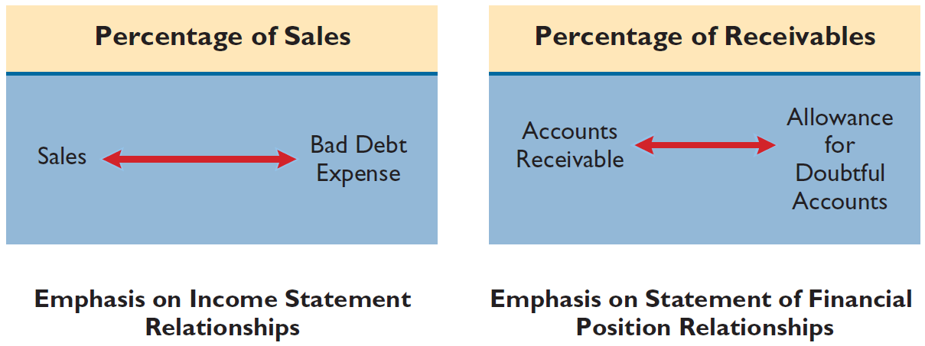
Allowance Method
ILLUSTRATION 7-7
Comparison of Bases for
Estimating Uncollectibles
The percentage-of-sales basis results in a better matching of expenses with revenues
The percentage-of-receivables
basis produces the better estimate of cash realizable value
LO 5

Slide 4
Allowance Method
Percentage-of-Sales Approach
Percentage based upon past experience and anticipate credit policy.
Achieves better matching of cost and revenues.
Any balance in Allowance for Doubtful Accounts is ignored.
Method frequently referred to as the income statement approach.
LO 5

Slide 5
Percentage-of-Sales Approach
Illustration: Gonzalez Company estimates that about 1% of net credit sales will become uncollectible. If net credit sales are R$800,000 for the year, it records bad debt expense as follows.
Bad Debt Expense (1% x R$800,000) 8,000
Allowance for Doubtful Accounts 8,000
ILLUSTRATION 7-8
LO 5

Slide 6
Allowance Method
Percentage-of-Receivables Approach
Not matching.
Estimate of the receivables’ realizable value.
Companies may apply this method using
one composite rate, or
an aging schedule using different rates.
LO 5

Slide 7
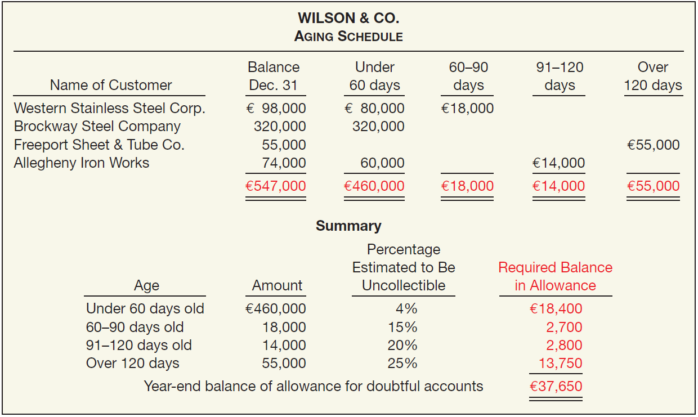
Percentage-of-Receivables Approach
ILLUSTRATION 7-9
Accounts Receivable Aging Schedule
What entry would Wilson make assuming that the allowance account had a zero balance?
Bad Debt Expense 37,650
Allowance for Doubtful Accounts 37,650
LO 5

Slide 8
Percentage-of-Receivables Approach
ILLUSTRATION 7-9
Accounts Receivable Aging Schedule
What entry would Wilson make assuming the allowance account had a credit balance of €800 before adjustment?
Bad Debt Expense (€37,650 – €800) 36,850
Allowance for Doubtful Accounts 36,850
LO 5

