Slide 1
11
Depreciation
LEARNING OBJECTIVES
Explain the concept of depreciation.
Identify the factors involved in the depreciation process.
Compare activity, straight-line, and diminishing-charge methods of depreciation.

Slide 2
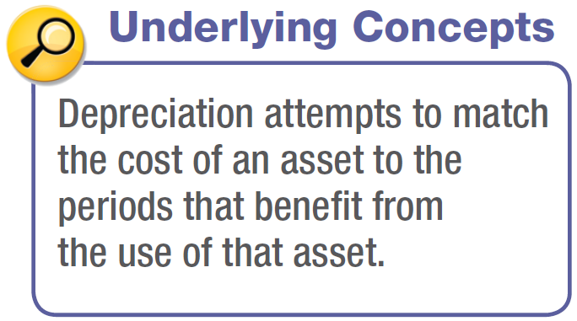
DEPRECIATION—COST ALLOCATION
Methods of Depreciation
The profession requires the method employed be “systematic and rational.” Methods used include:
Activity method (units of use or production).
Straight-line method.
Diminishing (accelerated)-charge methods:
Sum-of-the-years’-digits.
Declining-balance method.
LO 3

Slide 3
Methods of Depreciation
Activity Method
ILLUSTRATION 11-2
Data Used to Illustrate
Depreciation Methods
Data for Stanley Coal Mines
Illustration: If Stanley uses the crane for 4,000 hours the first year, the depreciation charge is:
ILLUSTRATION 11-3
Depreciation Calculation,
Activity Method—Crane
Example
LO 3

Slide 4
Methods of Depreciation
Straight-Line Method
ILLUSTRATION 11-2
Data Used to Illustrate
Depreciation Methods
Data for Stanley Coal Mines
Illustration: Stanley computes depreciation as follows:
ILLUSTRATION 11-4
Depreciation Calculation,
Straight-Line Method—Crane Example
LO 3

Slide 5
Methods of Depreciation
Diminishing-Charge Methods
ILLUSTRATION 11-2
Data Used to Illustrate
Depreciation Methods
Data for Stanley Coal Mines
Sum-of-the-Years’-Digits. Each fraction uses the sum of the years as a denominator (5 + 4 + 3 + 2 + 1 = 15). The numerator is the number of years of estimated life remaining as of the beginning of the year.
Alternate sum-of-the-years’ calculation
n(n+1)
5(5+1)
=
=
15
2
2
LO 3

Slide 6
Methods of Depreciation
Sum-of-the-Years’-Digits
ILLUSTRATION 11-6
Sum-of-the-Years’-Digits
Depreciation Schedule—
Crane Example
LO 3

Slide 7
Methods of Depreciation
Diminishing-Charge Methods
ILLUSTRATION 11-2
Data Used to Illustrate
Depreciation Methods
Data for Stanley Coal Mines
Declining-Balance Method.
Utilizes a depreciation rate (percentage) that is some multiple of the straight-line method.
Does not deduct the salvage value in computing the depreciation base.
LO 3

Slide 8
Methods of Depreciation
Declining-Balance Method
ILLUSTRATION 11-7
Double-Declining
Depreciation Schedule—
Crane Example
LO 3

