Slide 1
VALUATION OF PP&E
Exchanges of Non-Monetary Assets
Ordinarily accounted for on the basis of:
the fair value of the asset given up or
the fair value of the asset received,
whichever is clearly more evident.
Companies should recognize immediately any gains or losses on the exchange when the transaction has commercial substance.
LO 5

Slide 2
Exchanges of Non-Monetary Assets
Meaning of Commercial Substance
Exchange has commercial substance if the future cash flows change as a result of the transaction. That is, if the two parties’ economic positions change, the transaction has commercial substance.
ILLUSTRATION 10-10
Accounting for Exchanges
LO 5

Slide 3
Exchanges of Non-Monetary Assets
Exchanges—Loss Situation
Companies recognize a loss immediately whether the exchange has commercial substance or not.
Rationale: Companies should not value assets at more than their cash equivalent price; if the loss were deferred, assets would be overstated.
LO 5

Slide 4
Exchanges of Non-Monetary Assets
Illustration: Information Processing, Inc. trades its used machine for a new model at Jerrod Business Solutions Inc. The exchange has commercial substance. The used machine has a book value of €8,000 (original cost €12,000 less €4,000 accumulated depreciation) and a fair value of €6,000. The new model lists for €16,000. Jerrod gives Information Processing a trade-in allowance of €9,000 for the used machine. Information Processing computes the cost of the new asset as follows.
ILLUSTRATION 10-11
Computation of Cost of
New Machine
LO 5

Slide 5
Exchanges of Non-Monetary Assets
Illustration: Information Processing records this transaction as follows:
Equipment 13,000
Accumulated Depreciation—Equipment 4,000
Loss on Disposal of Equipment 2,000
Equipment 12,000
Cash 7,000
ILLUSTRATION 10-12
Computation of Loss
on Disposal of Used
Machine
Loss on Disposal
LO 5

Slide 6
Exchanges of Non-Monetary Assets
Exchanges—Gain Situation
Has Commercial Substance. Company usually records the cost of a non-monetary asset acquired in exchange for another non-monetary asset at the fair value of the asset given up, and immediately recognizes a gain.
LO 5

Slide 7
Exchanges of Non-Monetary Assets
Illustration: Interstate Transportation Company exchanged a number of used trucks plus cash for a semi-truck. The used trucks have a combined book value of $42,000 (cost $64,000 less $22,000 accumulated depreciation). Interstate’s purchasing agent, experienced in the secondhand market, indicates that the used trucks have a fair market value of $49,000. In addition to the trucks, Interstate must pay $11,000 cash for the semi-truck. Interstate computes the cost of the semi-truck as follows.
Illustration 10-13
Computation of Semi-Truck Cost
LO 5

Slide 8
Exchanges of Non-Monetary Assets
Illustration: Interstate records the exchange transaction as follows:
Truck (semi) 60,000
Accumulated Depreciation—Trucks 22,000
Trucks (used) 64,000
Gain on Disposal of Trucks 7,000
Cash 11,000
ILLUSTRATION 10-14
Computation of Gain on Disposal of Used Trucks
Gain on Disposal
LO 5

Slide 9
Exchanges of Non-Monetary Assets
Exchanges—Gain Situation
Lacks Commercial Substance. Now assume that Interstate Transportation Company exchange lacks commercial substance.
Interstate defers the gain of $7,000 and reduces the basis of the semi-truck.
LO 5

Slide 10
Exchanges of Non-Monetary Assets
Illustration: Interstate records the exchange transaction as follows:
Trucks (semi) 53,000
Accumulated Depreciation—Trucks 22,000
Trucks (used) 64,000
Cash 11,000
ILLUSTRATION 10-15
Basis of Semi-Truck—
Fair Value vs. Book Value
LO 5

Slide 11
Exchanges of Non-Monetary Assets
Summary of Gain and Loss Recognition on Exchanges of Non-Monetary Assets
ILLUSTRATION 10-16
Disclosure include
nature of the transaction(s),
method of accounting for the assets exchanged, and
gains or losses recognized on the exchanges.
LO 5

Slide 12
VALUATION OF PP&E
Government Grants
Government Grants are assistance received from a government in the form of transfers of resources to a company in return for past or future compliance with certain conditions relating to the operating activities of the company.
IFRS requires grants to be recognized in income (income approach) on a systematic basis that matches them with the related costs that they are intended to compensate.
LO 5

Slide 13
Government Grants
Example 1: Grant for Lab Equipment. AG Company received a €500,000 subsidy from the government to purchase lab equipment on January 2, 2015. The lab equipment cost is €2,000,000, has a useful life of five years, and is depreciated on the straight-line basis.
IFRS allows AG to record this grant in one of two ways:
Credit Deferred Grant Revenue for the subsidy and amortize the deferred grant revenue over the five-year period.
Credit the lab equipment for the subsidy and depreciate this amount over the five-year period.
LO 5

Slide 14
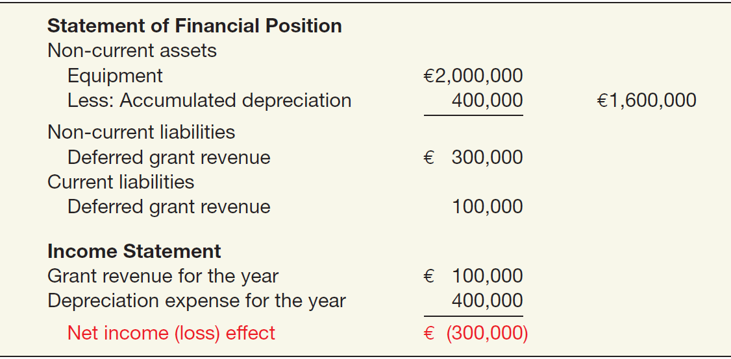
Government Grants
Example 1: Grant for Lab Equipment. If AG chooses to record deferred revenue of €500,000, it amortizes this amount over the five-year period to income (€100,000 per year). The effects on the financial statements at December 31, 2015, are:
ILLUSTRATION 10-17
Government Grant
Recorded as Deferred
Revenue
LO 5

Slide 15
Government Grants
Example 1: Grant for Lab Equipment. If AG chooses to reduce the cost of the lab equipment, AG reports the equipment at €1,500,000 (€2,000,000 - €500,000) and depreciates this amount over the five-year period. The effects on the financial statements at December 31, 2015, are:
ILLUSTRATION 10-18
Government Grant Adjusted to Asset
LO 5

Slide 16
10
Acquisition and Disposition of Property, Plant, and Equipment
LEARNING OBJECTIVES
After studying this chapter, you should be able to:
Describe property, plant, and equipment.
Identify the costs to include in initial valuation of property, plant, and equipment.
Describe the accounting problems associated with self-constructed assets.
Describe the accounting problems associated with interest capitalization.
Understand accounting issues related to acquiring and valuing plant assets.
Describe the accounting treatment for costs subsequent to acquisition.
Describe the accounting treatment for the disposal of property, plant, and equipment.

Slide 17
COSTS SUBSEQUENT TO ACQUISITION
Recognize costs subsequent to acquisition as an asset when the costs can be measured reliably and it is probable that the company will obtain future economic benefits.
Evidence of future economic benefit would include increases in
useful life,
quantity of product produced, and
quality of product produced.
LO 6

Slide 18
COSTS SUBSEQUENT TO ACQUISITION
ILLUSTRATION 10-21 Summary of Costs Subsequent to Acquisition
LO 6

Slide 19
10
Acquisition and Disposition of Property, Plant, and Equipment
LEARNING OBJECTIVES
After studying this chapter, you should be able to:
Describe property, plant, and equipment.
Identify the costs to include in initial valuation of property, plant, and equipment.
Describe the accounting problems associated with self-constructed assets.
Describe the accounting problems associated with interest capitalization.
Understand accounting issues related to acquiring and valuing plant assets.
Describe the accounting treatment for costs subsequent to acquisition.
Describe the accounting treatment for the disposal of property, plant, and equipment.

Slide 20
DISPOSITION OF PROPERTY, PLANT, AND EQUIPMENT
A company may retire plant assets voluntarily or dispose of them by
Sale,
Exchange,
Involuntary conversion, or
Abandonment.
Depreciation must be taken up to the date of disposition.
LO 7

Slide 21
DISPOSITION OF PP&E
Sale of Plant Assets
Illustration: Barret Company recorded depreciation on a machine costing €18,000 for nine years at the rate of €1,200 per year. If it sells the machine in the middle of the tenth year for €7,000, Barret records depreciation to the date of sale as:
Depreciation Expense (€1,200 x ½) 600
Accumulated Depreciation—Machinery 600
LO 7

Slide 22
DISPOSITION OF PP&E
Illustration: Barret Company recorded depreciation on a machine costing $18,000 for 9 years at the rate of $1,200 per year. If it sells the machine in the middle of the tenth year for $7,000, Barret records depreciation to the date of sale. Record the entry to record the sale of the asset:
Cash 7,000
Accumulated Depreciation—Machinery 11,400
Machinery 18,000
Gain on Disposal of Machinery 400
LO 7

Slide 23
DISPOSITION OF PP&E
Involuntary Conversion
Sometimes an asset’s service is terminated through some type of involuntary conversion such as fire, flood, theft, or condemnation.
Companies report the difference between the amount recovered (e.g., from a condemnation award or insurance recovery), if any, and the asset’s book value as a gain or loss.
They treat these gains or losses like any other type of disposition.
LO 7

Slide 24
DISPOSITION OF PP&E
Illustration: Camel Transport Corp. had to sell a plant located on company property that stood directly in the path of an interstate highway. Camel received $500,000, which substantially exceeded the book value of the land of $150,000 and the book value of the building of $100,000 (cost of $300,000 less accumulated depreciation of $200,000). Camel made the following entry.
Cash 500,000
Accumulated Depreciation—Buildings 200,000
Buildings 300,000
Land 150,000
Gain on Disposal of Plant Assets 250,000
LO 7

Slide 25
COPYRIGHT
Copyright © 2014 John Wiley & Sons, Inc. All rights reserved. Reproduction or translation of this work beyond that permitted in Section 117 of the 1976 United States Copyright Act without the express written permission of the copyright owner is unlawful. Request for further information should be addressed to the Permissions Department, John Wiley & Sons, Inc. The purchaser may make back-up copies for his/her own use only and not for distribution or resale. The Publisher assumes no responsibility for errors, omissions, or damages, caused by the use of these programs or from the use of the information contained herein.

