Slide 1
VALUATION OF PP&E
Government Grants
Government Grants are assistance received from a government in the form of transfers of resources to a company in return for past or future compliance with certain conditions relating to the operating activities of the company.
IFRS requires grants to be recognized in income (income approach) on a systematic basis that matches them with the related costs that they are intended to compensate.
LO 5

Slide 2
Government Grants
Example 1: Grant for Lab Equipment. AG Company received a €500,000 subsidy from the government to purchase lab equipment on January 2, 2015. The lab equipment cost is €2,000,000, has a useful life of five years, and is depreciated on the straight-line basis.
IFRS allows AG to record this grant in one of two ways:
Credit Deferred Grant Revenue for the subsidy and amortize the deferred grant revenue over the five-year period.
Credit the lab equipment for the subsidy and depreciate this amount over the five-year period.
LO 5

Slide 3
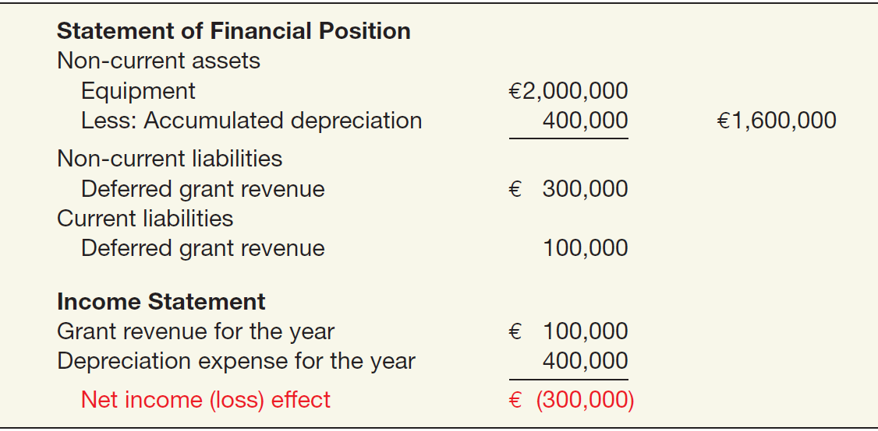
Government Grants
Example 1: Grant for Lab Equipment. If AG chooses to record deferred revenue of €500,000, it amortizes this amount over the five-year period to income (€100,000 per year). The effects on the financial statements at December 31, 2015, are:
ILLUSTRATION 10-17
Government Grant
Recorded as Deferred
Revenue
LO 5

Slide 4
Government Grants
Example 1: Grant for Lab Equipment. If AG chooses to reduce the cost of the lab equipment, AG reports the equipment at €1,500,000 (€2,000,000 - €500,000) and depreciates this amount over the five-year period. The effects on the financial statements at December 31, 2015, are:
ILLUSTRATION 10-18
Government Grant Adjusted to Asset
LO 5

Slide 5
10
Acquisition and Disposition of Property, Plant, and Equipment
LEARNING OBJECTIVES
After studying this chapter, you should be able to:
Describe property, plant, and equipment.
Identify the costs to include in initial valuation of property, plant, and equipment.
Describe the accounting problems associated with self-constructed assets.
Describe the accounting problems associated with interest capitalization.
Understand accounting issues related to acquiring and valuing plant assets.
Describe the accounting treatment for costs subsequent to acquisition.
Describe the accounting treatment for the disposal of property, plant, and equipment.

Slide 6
COSTS SUBSEQUENT TO ACQUISITION
Recognize costs subsequent to acquisition as an asset when the costs can be measured reliably and it is probable that the company will obtain future economic benefits.
Evidence of future economic benefit would include increases in
useful life,
quantity of product produced, and
quality of product produced.
LO 6

Slide 7
COSTS SUBSEQUENT TO ACQUISITION
ILLUSTRATION 10-21 Summary of Costs Subsequent to Acquisition
LO 6

Slide 8
10
Acquisition and Disposition of Property, Plant, and Equipment
LEARNING OBJECTIVES
After studying this chapter, you should be able to:
Describe property, plant, and equipment.
Identify the costs to include in initial valuation of property, plant, and equipment.
Describe the accounting problems associated with self-constructed assets.
Describe the accounting problems associated with interest capitalization.
Understand accounting issues related to acquiring and valuing plant assets.
Describe the accounting treatment for costs subsequent to acquisition.
Describe the accounting treatment for the disposal of property, plant, and equipment.

Slide 9
DISPOSITION OF PROPERTY, PLANT, AND EQUIPMENT
A company may retire plant assets voluntarily or dispose of them by
Sale,
Exchange,
Involuntary conversion, or
Abandonment.
Depreciation must be taken up to the date of disposition.
LO 7

Slide 10
DISPOSITION OF PP&E
Sale of Plant Assets
Illustration: Barret Company recorded depreciation on a machine costing €18,000 for nine years at the rate of €1,200 per year. If it sells the machine in the middle of the tenth year for €7,000, Barret records depreciation to the date of sale as:
Depreciation Expense (€1,200 x ½) 600
Accumulated Depreciation—Machinery 600
LO 7

Slide 11
DISPOSITION OF PP&E
Illustration: Barret Company recorded depreciation on a machine costing $18,000 for 9 years at the rate of $1,200 per year. If it sells the machine in the middle of the tenth year for $7,000, Barret records depreciation to the date of sale. Record the entry to record the sale of the asset:
Cash 7,000
Accumulated Depreciation—Machinery 11,400
Machinery 18,000
Gain on Disposal of Machinery 400
LO 7

Slide 12
DISPOSITION OF PP&E
Involuntary Conversion
Sometimes an asset’s service is terminated through some type of involuntary conversion such as fire, flood, theft, or condemnation.
Companies report the difference between the amount recovered (e.g., from a condemnation award or insurance recovery), if any, and the asset’s book value as a gain or loss.
They treat these gains or losses like any other type of disposition.
LO 7

Slide 13
DISPOSITION OF PP&E
Illustration: Camel Transport Corp. had to sell a plant located on company property that stood directly in the path of an interstate highway. Camel received $500,000, which substantially exceeded the book value of the land of $150,000 and the book value of the building of $100,000 (cost of $300,000 less accumulated depreciation of $200,000). Camel made the following entry.
Cash 500,000
Accumulated Depreciation—Buildings 200,000
Buildings 300,000
Land 150,000
Gain on Disposal of Plant Assets 250,000
LO 7

Slide 14
COPYRIGHT
Copyright © 2014 John Wiley & Sons, Inc. All rights reserved. Reproduction or translation of this work beyond that permitted in Section 117 of the 1976 United States Copyright Act without the express written permission of the copyright owner is unlawful. Request for further information should be addressed to the Permissions Department, John Wiley & Sons, Inc. The purchaser may make back-up copies for his/her own use only and not for distribution or resale. The Publisher assumes no responsibility for errors, omissions, or damages, caused by the use of these programs or from the use of the information contained herein.

