Slide 1
Lecture Four
Mathematical Expectation

Slide 2
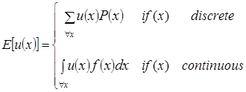
Definition
Let X be a r.v. and let u(x) be a function of X. Then, Mathematical Expectation value of u(x) will be:

Slide 3
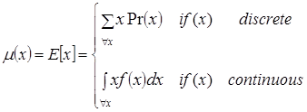
Mean
When u(x) = x →
When it exists it called the "arithmetic mean of the distribution" or merely called "The Mean" of r.v. X and denoted as µ_{x}.

Slide 4
Central Moments
The "r^{th}" central moment of r.v. X about the constant (a) is given by:

Slide 5
Non-central Moments
Sometimes called “Raw Moments” . The "r^{th}" raw moment of a r.v. X denoted by and defined as:

