Slide 1
Chapter Three Continuous Distributions

Slide 2
Uniform distribution (continuous
Inprobability theory and statistics, the continuous uniform distribution or a rectangular distribution, is a distribution that has constant probability. Uniform distribution is a family of symmetric probability distributions such that for each member of the family, all intervals of the same length on the distribution's support are equally probable. The continuous uniform distribution is the probability distribution of random number selection from the continuous interval between a and b.

Slide 3
Probability density function
The probability density function of the continuous uniform distribution is:
$f\left(x\right)=\left\{\begin{aligned}\frac{1}{b−a} a≤&x≤b \\ 0 \\ other wise\end{aligned}\right.$
The values of f(x) at the two boundaries a and b are usually unimportant because they do not alter the values of the integrals of f(x) dx over any interval, nor of x f(x) dx or any higher moment. Sometimes they are chosen to be zero, and sometimes chosen to be$\frac{1}{b−a}$. The latter is appropriate in the context of estimation by the method of maximum likelihood.

Slide 4
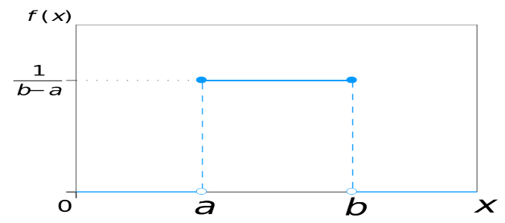
The p.d.f

Slide 5

To prove the f(x) of uniform distribution is p.d.f, that is
$f\left(x\right)=\int_{−∞}^{∞}{f(x)dx}=1$
$f\left(x\right)=\int_{a}^{b}{\frac{1}{b−a}dx}=\frac{1}{b−a}\int_{a}^{b}{dx}=\frac{1}{b−a}x{b \atop a} =\frac{b−a}{b−a}=1$

Slide 6
Cumulative distribution function
The cumulative distribution function is:
$F\left(x\right)=pr\left(X≤x\right)$
$F\left(x\right)=\int_{−∞}^{x}{f(x)dx}$
$F\left(X≤x\right)=\int_{a}^{x}{\frac{1}{b−a}du=\frac{1}{b−a}\int_{a}^{u}{du}=\frac{1}{b−a}u{b \atop a} =\frac{x−a}{b−a}}$
$F\left(x\right)=\left\{\begin{aligned}0 x<a \\ \frac{x−a}{b−a} a≤x<b \\ 1 x≥b\end{aligned}\right.$

Slide 8
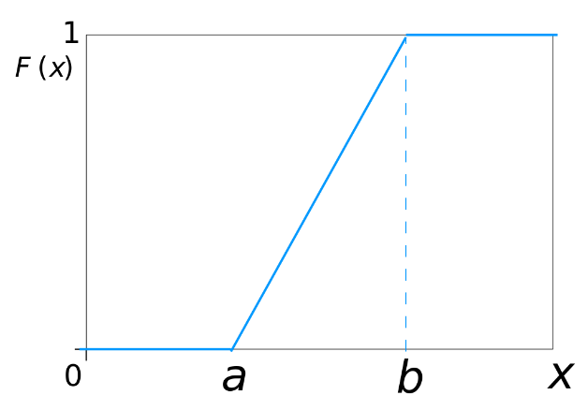
Cumulative distribution
C.D.F

Slide 9

Expectation and Variance
If X ~ U (a , b), then:
$E\left(X\right)=\frac{(a+b)}{2}$
$Variance\left(X\right)=Var\left(X\right)=\frac{{(b−a)}^{2}}{12}$
Proof of Expectation
$\int_{a}^{b}{\frac{x}{b−a}}dx=\frac{1}{b−a}{\left[\frac{x^{2}}{2}\right]}_{a}^{b}=\frac{b^{2}−a^{2}}{2(b−a)}=\frac{b+a}{2}$
Example 3.1

Slide 10
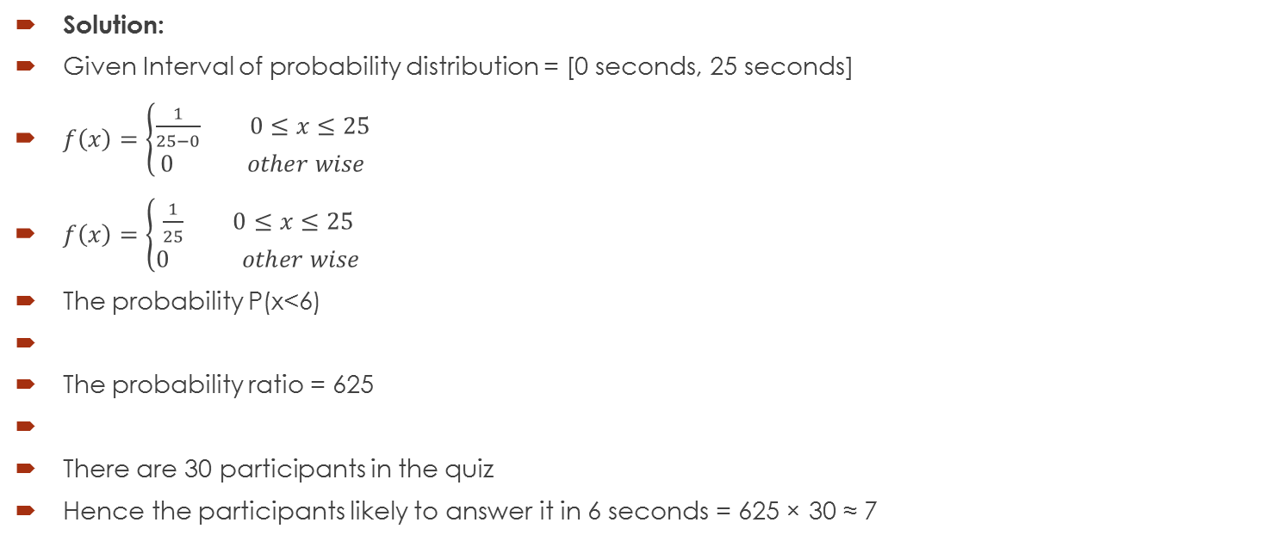
Example 3.1 Suppose in a quiz there are 30 participants. A question is given to all 30 participants and the time allowed to answer it in 25 seconds. Find the probability of participants responds within 6 seconds
Solution:
Given Interval of probability distribution = [0 seconds, 25 seconds]
$f\left(x\right)=\left\{\begin{aligned}\frac{1}{25−0} 0≤&x≤25 \\ 0 other wise\end{aligned}\right.$
$f\left(x\right)=\left\{\begin{aligned}\frac{1}{25} 0≤&x≤25 \\ 0 other wise\end{aligned}\right.$
The probability P(x<6)
The probability ratio = 625
There are 30 participants in the quiz
Hence the participants likely to answer it in 6 seconds = 625 × 30 ≈ 7

