Slide 1
Lecture Ten
Double Integrals

Slide 2
Double Integrals
Integrals of a function of two variables over a region in R² are called double integrals. Just as the definite integral of a positive function of one variable represents the area of the region between the graph of the function and the x-axis, the double integral of a positive function of two variables represents the volume of the region between the surface defined by the function and the plane which contains its domain.

Slide 3
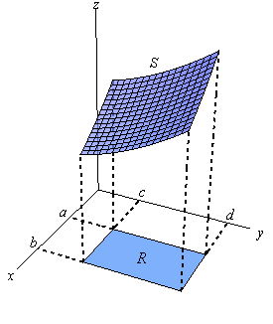
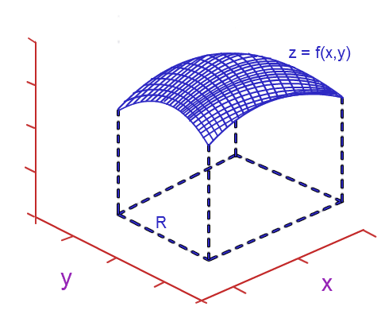
Double Integrals (Cont.)
A double integral is an integral used to evaluate the volume of a three dimensional solid under the surface z = f(x,y) with respect to x and y. A double integral is an iterated integral. The integral is iterated twice.

Slide 4
Double Integrals (Cont.)
Exercises:
Q1. Evaluate the following double integrals:
Q2. Show that:

Slide 5
Double Integrals (Cont.)
Definition: The AREA A of a region R in the x y- plane is given by the double integral:
Definition: The VOLUME V beneath the surface
and above a region R in the x y- plane is:
Fubini's Theorem:
If f (x, y) is continuous on R=[a,b] X [c,d]. then,
These integrals are called iterated integrals.

Slide 6
Double Integrals (Cont.)
Note: Rectangular regions are easy because the limits and are fixed , meaning the ranges of x and y don't depend on each other.
For regions of other shapes, the range of one variable will depend on the other.
In a double integral, the outer limits must be constant, but the inner limits can depend on the outer variable.

