Slide 1
Lecture Ten
Some Characteristic Multivariate Normal Distribution

Slide 2
Representing the Exponent of MVN as Quadratic Form
For bivariate case (p=2) of standard normal for the above f(z) is given by:
where:

Slide 3
Moment Generating Function of MVN
The moment generating function (m.g.f.) of $\underline{x}$ is a function from $R→[0,∞)$, given by:
$${M_{x}}^{(t)}={M_{x}}^{(t_{1},,t_{2,}…,t_{p})}=E\left[e^{t_{1}x_{1}+……+t_{p}x_{p}}\right]$$
$=E\left[e^{\underline{x} \underline{t^{′}}}\right]$
for t=(t₁,..,t_{p}). where is:

Slide 4
It is very useful in distribution theory especially correlations (sum of independent random variables) asymptotic, and for generating moments. The main use we have is that the m.g.f. determines the distribution.

Slide 5
Two important probability of moment generating function:
1- If two random vectors have the same moment generating function, if and only if they have the same density. This property is called the “ uniqueness” of moment generating function.
2- Two random vectors are independent if and only if their joint moment generating function factors into the product of their two separate m.g.f., that is if:
${\underline{x}}^{′}=\left(x_{1}^{′},x_{2}^{′}\right) and {\underline{t}}^{′}=(t_{1}^{′},t_{2}^{′})$,
then x₁ and x₂ are independent if and only if:
$M_{\underline{x}}\left(t\right)=M_{x_{1}}\left(t\right){ M}_{x_{2}}\left(t\right).$

Slide 6
The Standard Normal Distribution
The adjective '' standard '' indicates the special case in which the mean is equal to zero and the variance is equal to one.
Definition: Let x be a continuous random variable. Let its support of random variable (is the set of values that the random variable can take), be the whole set of real numbers: $R_{X}=ℝ^{K}.$
We say that x has a standard normal distribution if and only if its probability density function is
$f\left(x\right)=\frac{1}{\sqrt{2π}}exp \left(− \frac{1}{2} x^{2} \right).$

Slide 7
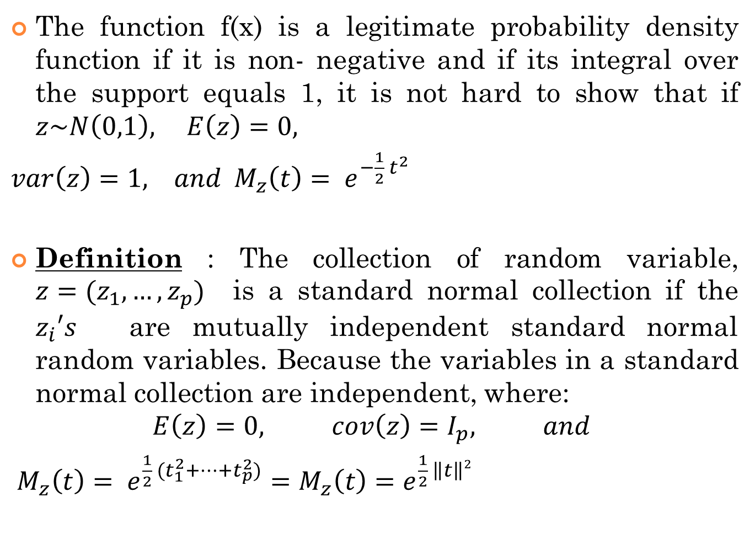
The function f(x) is a legitimate probability density function if it is non- negative and if its integral over the support equals 1, it is not hard to show that if $z\sim N\left(0,1\right), E\left(z\right)=0,$
$var\left(z\right)=1, and M_{z}\left(t\right)= e^{−\frac{1}{2} t^{2}}$
Definition : The collection of random variable, $z=(z_{1},…,z_{p})$ is a standard normal collection if the $z_{i}′s$ are mutually independent standard normal random variables. Because the variables in a standard normal collection are independent, where:
$$E\left(z\right)=0, cov\left(z\right)=I_{p}, and$$
$M_{z}\left(t\right)= e^{\frac{1}{2} (t_{1}^{2}+…+t_{p}^{2})}=M_{z}\left(t\right)=e^{\frac{1}{2} \left\|t\right\|2}$

