Slide 1
Lecture Seven
Differentiation with Vectors and Matrices

Slide 2
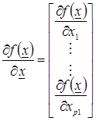
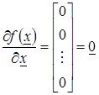
The vector of partial derivatives is:
If f(x) is constant for all x ; then:

Slide 3
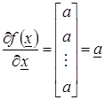
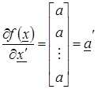
If f(x) = a'x = x'a , then:

Slide 4
If f(x) = x'Ax ; (A is symmetric) ; then:
If ( A is not symmetric A≠A') ; then:
If f(x) = x'Ax ; (A is identity) ; then:

Slide 5
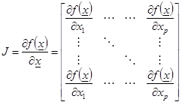
Jacobi Matrix
It represents the first derivative of some function with respect to x vector.

Slide 6
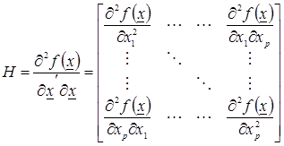
Hessian Matrix
It represents the second derivative of some function with respect to x' and x vectors respectively.

