Slide 1
Lecture Eight
Area Under a Curve

Slide 2
Area Under a Curve
It is important to sketch the situation before we start. We wish to find the area under the curve y=f(x) from x=a to x=b. We can have several situations:

Slide 3
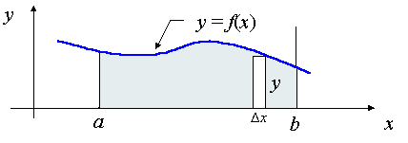
Area Under a Curve (Cont.)
Case I: Curves which are entirely above the x-axis
In this case, we find the area by simply finding the integral

Slide 4
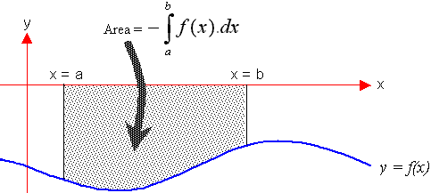
Area Under a Curve (Cont.)
Case II: Curves which are entirely below the x-axis
In this case, we find the area by finding the integral

Slide 5
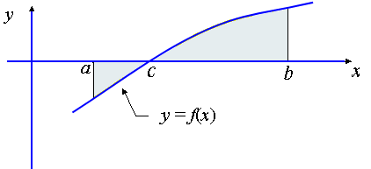
Area Under a Curve (Cont.)
Case III: Part of the curve is above the x-axis
and part of the curve is below the x-axis In this case, we find the area by finding the integral

