Slide 1
Lecture Eight
Determination of Maxima and Minima Maximization (Q.F.)

Slide 2
Quadratic form can be represented as :
To maximizing / (minimizing) some function f(x) subjected a constrain: g(x) = c on values of x and for more general method is that of "Lagrange Multiplier".

Slide 3
From a new function:

Slide 4
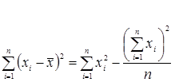
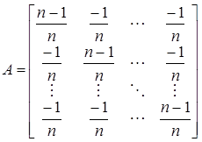
Note
If the Q.F. is to be maximum then λ must be the greater characteristic root of A and x is associated vector. Similarly , if the Q.F. is to be minimum then λ must be the minimum characteristic root of A.
As a special case :

