Slide 1
Lecture Nine
Area between curves

Slide 2
Area between curves
A similar technique that we used to find the area under a curve can also be employed to find the area bounded between two curves about the x-axis.

Slide 3
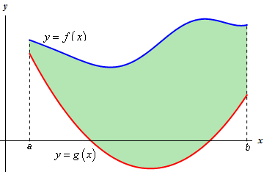
Area between curves (Cont.)
Case I. The area between the curves y = f (x) and y = g (x) and the ordinates x = a and
x = b is:

Slide 4
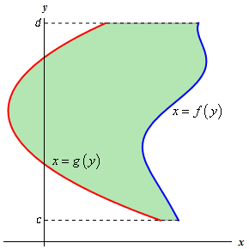
Area between curves (Cont.)
Case II. The area between the curves x = f (y) and x = g (y) and bounded between y = c and y = d is:

