Slide 1
Lecture Nine
Multivariate Normal Distribution (MVN)

Slide 2
Let x_{i} ~ N(μ_{i} , σ), then the probability density function is defined as:
Letting: are independent identical distributed with normal distribution, then the joint distribution of x will be as:

Slide 3
Definition: For more general case of the above the random vector x will distribute as:
said to have a multivariate normal distribution with mean vector ( ) and variance-covariance matrix (Σ).

Slide 4
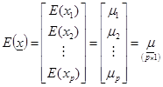
x ~ N_{p}(μ , Σ)
Σ is symmetric matrix (σ_{ij} = σ_{ji}) and positive definite, non-singular matrix, (σ_{ii} = σ_{i}²) ,

Slide 5
Some properties of the mean and variance for a vector
Let a, b, c and d are constants , a & b are vectors , A & B are matrices.
1- E(ax) = a·E(x)
2- E(ax ± by) = a·E(x) ± b·E(y)
3- E(a'x) = a'μ

Slide 6
4-
5- Cov(x , x) = Var(x)
6- Var(x ± a) = Var(x) = Σ
7- Cov(y , x) = Cov(x , y)
8- Cov(x_{i}±a , x_{j}±b) = Cov(x_{i} , x_{j})
9-
10- Cov(cx_{i} , dx_{j}) = cd Cov(x_{i} , x_{j})

Slide 7
11-
12-
13- If A is (p×n) with all elements are constants, then: Var(A) = A Var(x) A' = AΣA‘
14-
15- If x_{i} & x_{j} are independent, then:
cov(x_{i} , x_{j}) = 0 , but ingeneral the converse is not true → ρ_{ij} = 0

Slide 8
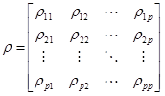
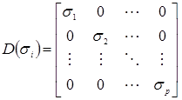
16- If Σ is the covariance matrix and is the correlation matrix (p.d.) then they are related as:
where σ_{i} is the standard deviations of the variates.

Slide 9
17- If we standardize each variates by:
then the density f(z) is given by:
ρ: is (p.d.) correlation matrix.

