Slide 1
Mathematical Statistics
Omar Abdulmohsin Ali
for
M.Sc. – level
1st Semester
2020

Slide 2
Lesson One
Transformations

Slide 3
Discrete Random Variable
If X a r.v. has pmf and given any function $Y= h \left(x\right)∋$ there is (one – to – one) points of x and there are y corresponding points. We call it: “one – to – one” transformation.
Then, $x=h^{−1}\left(y\right).$
$g\left(y\right)=P_{r}\left(Y=y\right){=P}_{r}\left(h\left(x\right)=y\right)=P_{r}\left(x={ h}^{−1}(y)\right)$
$∴⟹ P_{r}\left(h^{−1}\left(y\right)\right)=g\left(h^{−1}\left(y\right)\right)$

Slide 4
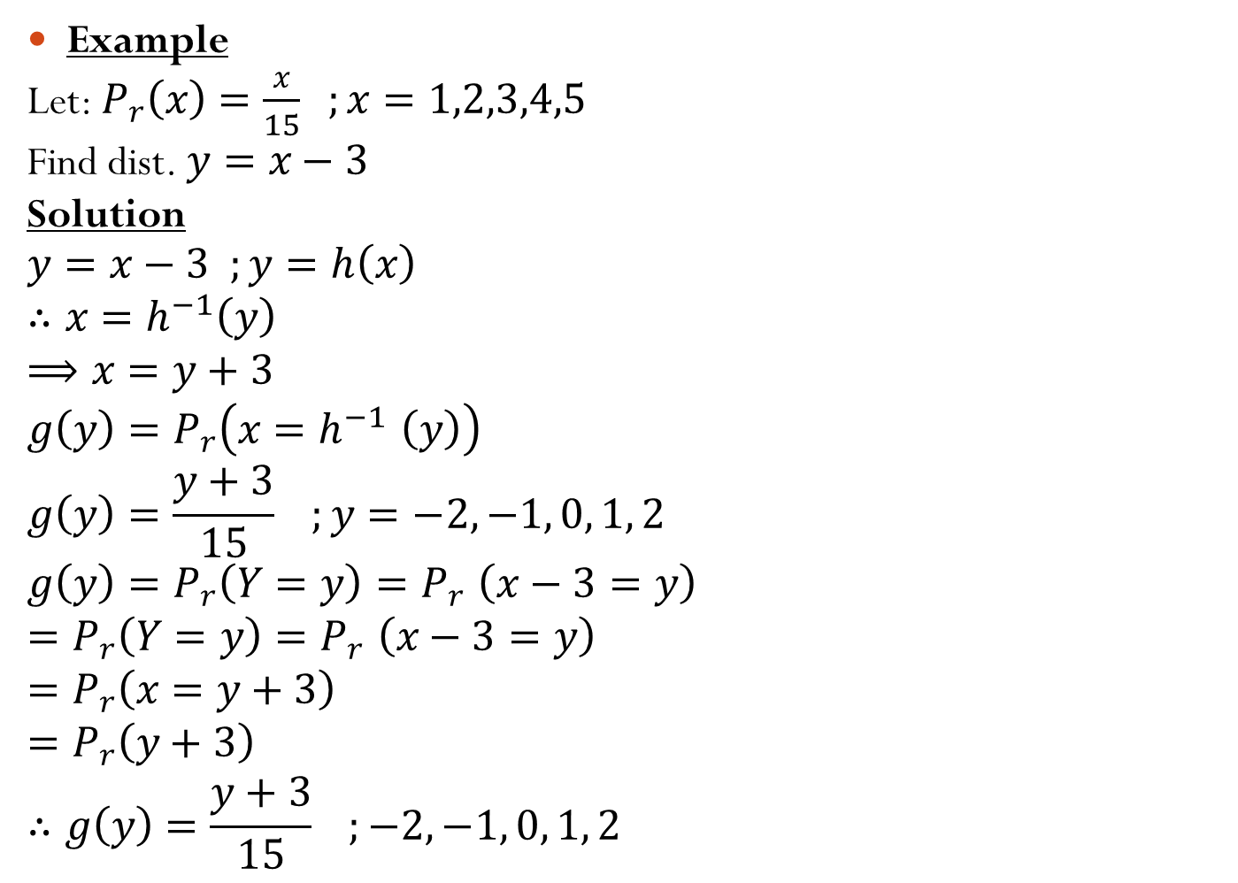
Example
Let: $P_{r}\left(x\right)=\frac{x}{15} ;x=1,2,3,4,5$
Find dist. $y=x−3$
Solution
$$y=x−3 ;y=h\left(x\right)$$
$$∴x=h^{−1}\left(y\right)$$
$$⟹x=y+3$$
$$g\left(y\right)=P_{r}\left(x{=h}^{−1}\left(y\right)\right)$$
$$g\left(y\right)=\frac{y+3}{15} ;y=−2, −1, 0, 1, 2$$
$$g\left(y\right)=P_{r}\left(Y=y\right){=P}_{r}\left(x−3=y\right)$$
$$=P_{r}\left(Y=y\right){=P}_{r}\left(x−3=y\right)$$
$$=P_{r}\left(x=y+3\right)$$
$$=P_{r}\left(y+3\right)$$
$$∴g\left(y\right)=\frac{y+3}{15} ;−2, −1, 0, 1, 2$$

Slide 5
Continuous Random Variable
If $x$ a r.v. has pdf $f(x)$ and given function $y=h\left(x\right)$, then:
$$g\left(y\right)=f\left(x\right).\left|\frac{dx}{dy}\right|$$
If:
$\left|\frac{dx}{dy}\right|=J$ which is jacobian or jacobi

Slide 6

Example
Let $x$has exponential distribution (λ=1)
$$f\left(x\right)=e^{−x} ;x>0$$
Find $g\left(y\right) if y=\sqrt{x}$
Solution
$$y=\sqrt{x} ⟶x=y^{2}$$
$$J=\left|\frac{dx}{dy}\right|=2y$$
$$∴g\left(y\right)=e^{−y^{2}}.2y ;y>0$$

