Slide 1
Lesson Two
Truncated Distribution

Slide 2
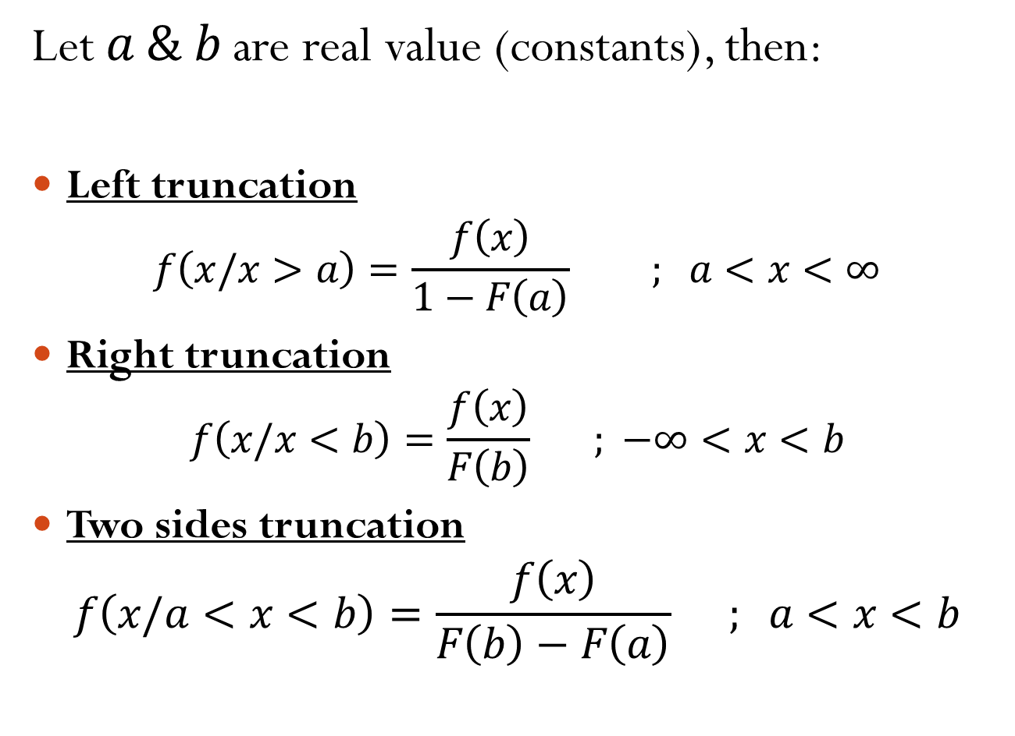
Let $a \& b$ are real value (constants), then:
Left truncation
$$f\left(x/x>a\right)=\frac{f\left(x\right)}{1−F\left(a\right)} ; a<x<∞$$
Right truncation
$$f\left(x/x<b\right)=\frac{f\left(x\right)}{F\left(b\right)} ; −∞<x<b$$
Two sides truncation
$$f\left(x/a<x<b\right)=\frac{f\left(x\right)}{F\left(b\right)−F\left(a\right)} ; a<x<b$$

Slide 3
Example
Let X ~ Exp(2) , then find:
i. f(x / x > 1)
ii. f(x / x < 1.2)
iii. f(x/ 1 <x<1.2)
Solution

