Slide 1
Lesson Three
Order Statistics

Slide 2
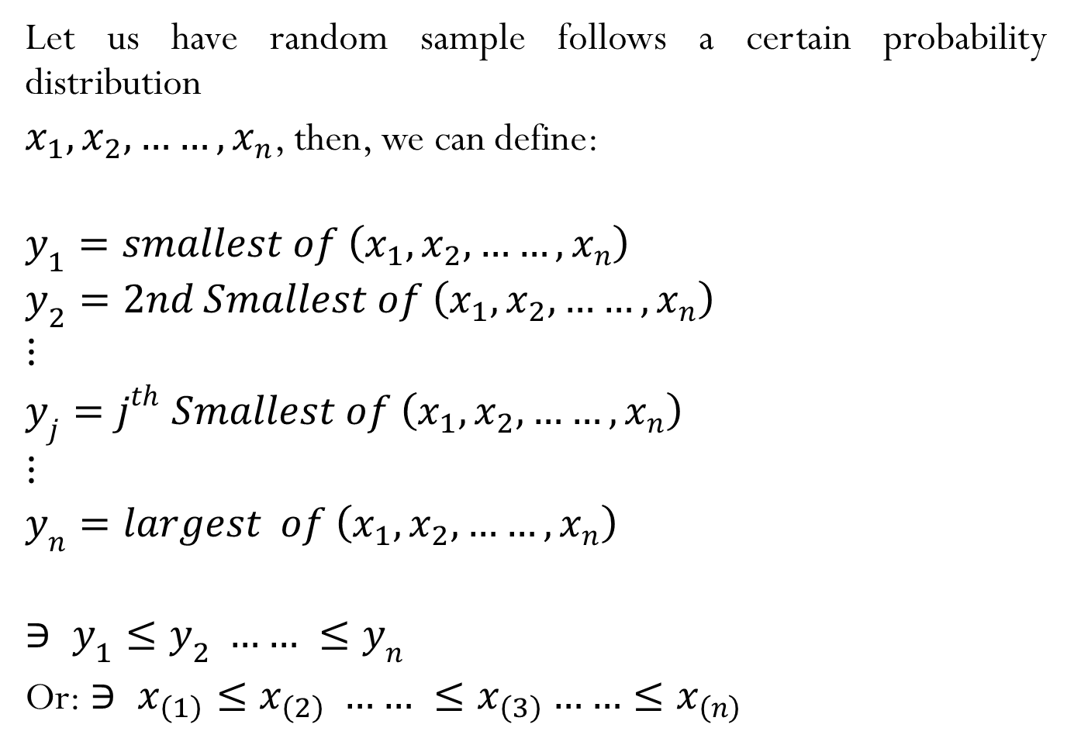
Let us have random sample follows a certain probability distribution
$x_{1}, x_{2}, ……, x_{n}$, then, we can define:
$$y_{1}=smallest of \left(x_{1}, x_{2}, ……, x_{n}\right)$$
$$y_{2}=2nd Smallest of \left(x_{1}, x_{2}, ……, x_{n}\right)$$
$$⋮$$
$$y_{j}=j^{th} Smallest of \left(x_{1}, x_{2}, ……, x_{n}\right)$$
$$⋮$$
$$y_{n}=largest of \left(x_{1}, x_{2}, ……, x_{n}\right)$$
$$∋ y_{1}≤y_{2} …… ≤y_{n}$$
Or: $∋ x_{\left(1\right)}≤x_{\left(2\right)} …… ≤x_{\left(3\right)}……≤x_{\left(n\right)}$

Slide 3
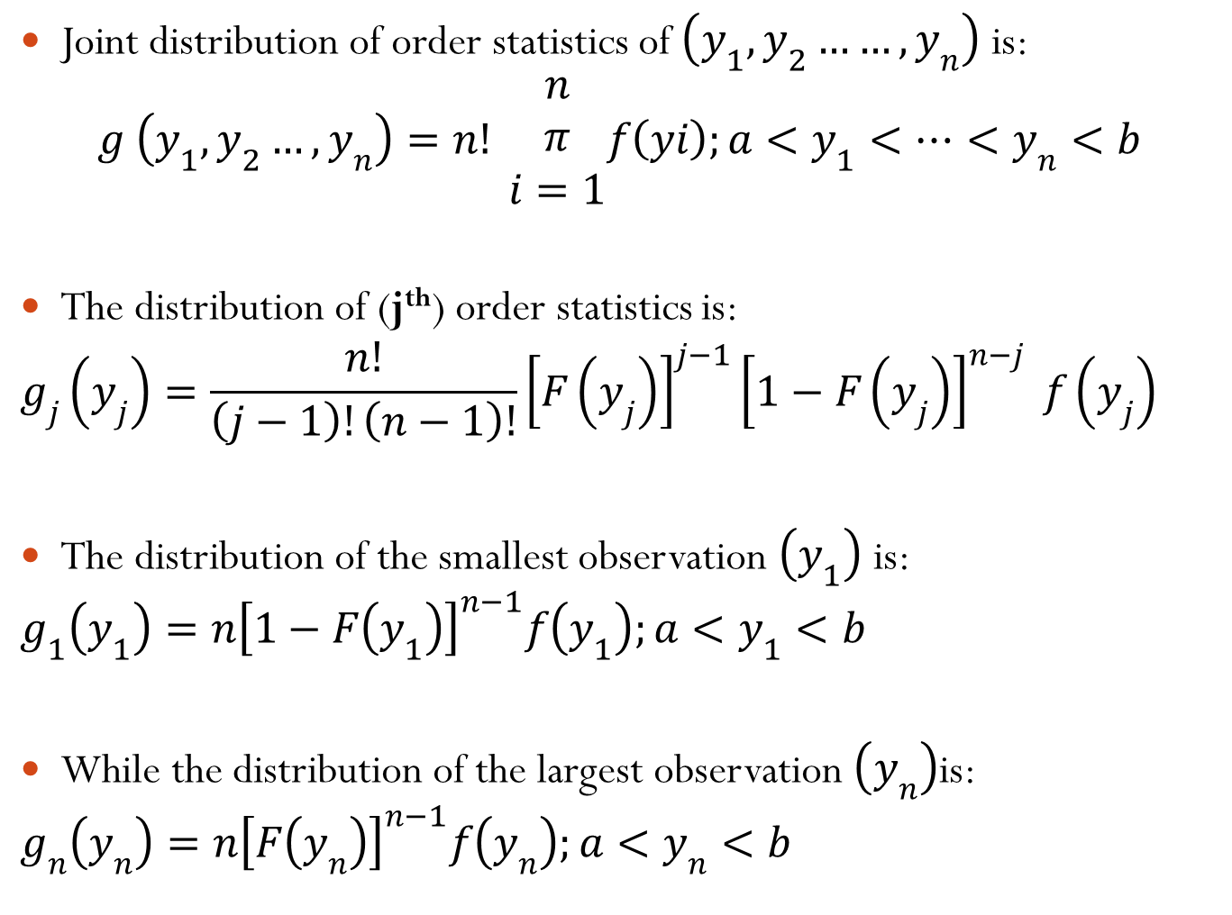
Joint distribution of order statistics of $\left(y_{1}, y_{2}……, y_{n}\right)$ is:
$$g \left(y_{1}, y_{2}…, y_{n}\right)=n! \begin{matrix}n \\ π \\ i=1\end{matrix}f\left(yi\right);a<y_{1}<…<y_{n}<b$$
The distribution of (j^{th}) order statistics is:
$$g_{j}\left(y_{j}\right)=\frac{n!}{\left(j−1\right)!\left(n−1\right)!}{\left[F\left(y_{j}\right)\right]}^{j−1}{\left[1−F\left(y_{j}\right)\right]}^{n−j} f\left(y_{j}\right)$$
The distribution of the smallest observation $\left(y_{1}\right)$ is:
$$g_{1}\left(y_{1}\right)=n{\left[1−F\left(y_{1}\right)\right]}^{n−1}f\left(y_{1}\right);a<y_{1}<b$$
While the distribution of the largest observation $\left(y_{n}\right)$is:
$$g_{n}\left(y_{n}\right)=n{\left[F\left(y_{n}\right)\right]}^{n−1}f\left(y_{n}\right);a<y_{n}<b$$

Slide 4
Example
Let$\left(x_{1}, x_{2},x_{3} ,x_{4}, x_{5}\right)$represent random sample of beta distribution with$\left(a=2\right), \left(b=1\right)$. Find the distribution of:
i. Largest order statistics.
ii. Smallest order statistics.
iii. ${ P}_{r}\left(y_{1}<0.2\right)$
iv. Third order statistics.

