Slide 1
Lesson Five
Marginal Distributions

Slide 2
Marginal probability function
If Pr(x) is discrete marginal probability, then:
$$P_{r}\left(x\right)=\sum_{∀y}{P_{r}\left(x,y\right)}$$
$$P_{r}\left(y\right)=\sum_{∀x}{P_{r}\left(x,y\right)}$$
If f(x) is continuous marginal probability, then:
$$f\left(x\right)=\int_{∀y}{f\left(x,y\right)dy}$$
$$f\left(y\right)=\int_{∀x}{f\left(x,y\right)dx}$$

Slide 3
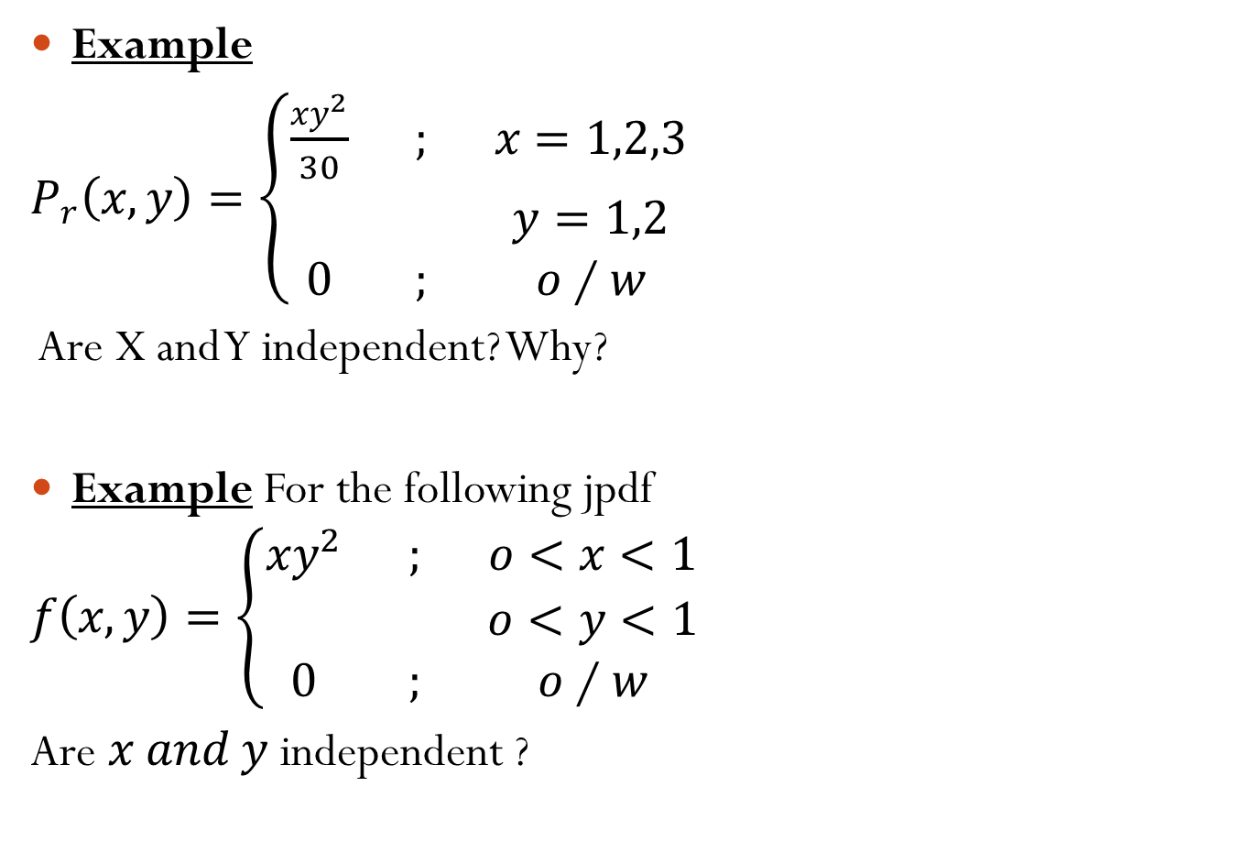
Example
$P_{r}\left(x,y\right)=\left\{\begin{matrix}\frac{xy^{2}}{30} & ; & x=1,2,3 \\ & & y=1,2 \\ 0 & ; & o∕w\end{matrix}\right.$
Are X and Y independent? Why?
Example For the following jpdf
$$f\left(x,y\right)=\left\{\begin{matrix}xy^{2} & ; & o<x<1 \\ & & o<y<1 \\ 0 & ; & o∕w\end{matrix}\right.$$
Are $x and y$ independent ?

Slide 4
Theorem
Let x and y are two r.v.'s then, x and y are independent iff:
$f\left(x,y\right)=f\left(x\right)∙ f\left(y\right)$ [for continuous r.v.]
$P_{r}\left(x,y\right)=P_{r}\left(x\right)∙ P_{r}\left(y\right)$ [for discrete r.v.]

