Slide 1
Lesson Six
Conditional Distributions

Slide 2
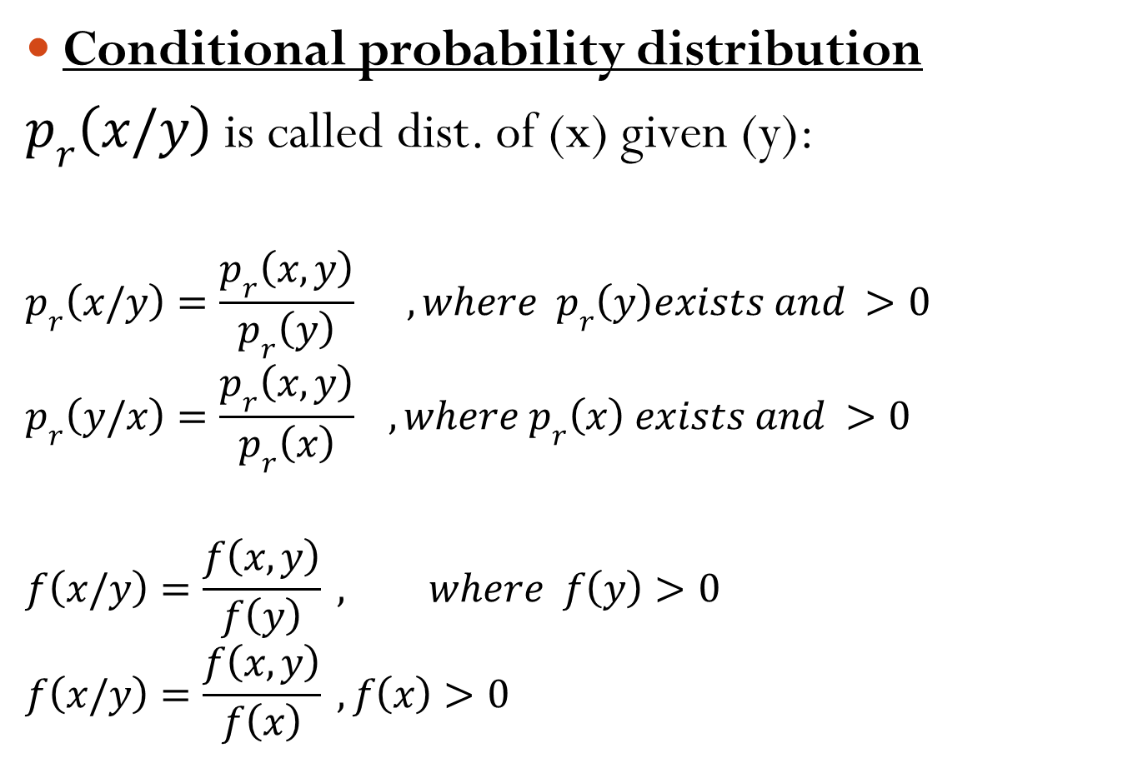
Conditional probability distribution
$p_{r}\left(x/y\right)$ is called dist. of (x) given (y):
$$p_{r}\left(x/y\right)=\frac{p_{r}\left(x,y\right)}{p_{r}\left(y\right)} ,where p_{r}\left(y\right)exists and >0$$
$$p_{r}\left(y/x\right)=\frac{p_{r}\left(x,y\right)}{p_{r}\left(x\right)} , {where p}_{r}\left(x\right) exists and >0$$
$$f\left(x/y\right)=\frac{f\left(x,y\right)}{f\left(y\right)} , where f\left(y\right)>0$$
$$f\left(x/y\right)=\frac{f\left(x,y\right)}{f\left(x\right)} , f\left(x\right)>0$$

Slide 3

Example
$$f\left(x,y\right)=\left\{\begin{matrix}x+y & ; & 0<x<1 \\ & & 0<y<1 \\ 0 & ; & o/w\end{matrix}\right.$$
Find:
$$f\left(x/y\right) ;f\left(y\right) exists$$
$$f\left(y/x\right) ;f\left(x\right) exists$$
$$P_{r}\left(−\frac{1}{2} <x<\frac{1}{4}/y=\frac{1}{2}\right)$$
$$P_{r}\left(y ≥\frac{1}{2}/x≥\frac{1}{2}\right)$$
$$P_{r}\left(x=3/y<2\right)$$
$$P_{r}\left(\frac{1}{2}<x<\frac{3}{4}/ y>5\right)$$

Slide 4
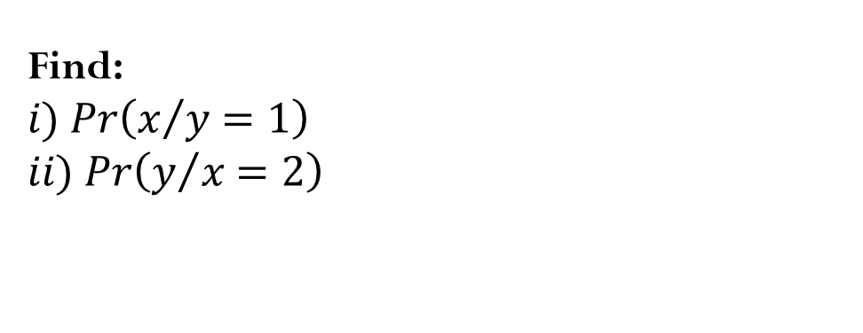
Example
Find:
$$i) Pr\left(x/y=1\right)$$
$$ii) Pr\left(y/x=2\right)$$

