Slide 1
Lesson Seven
Covariance of Distributions

Slide 2
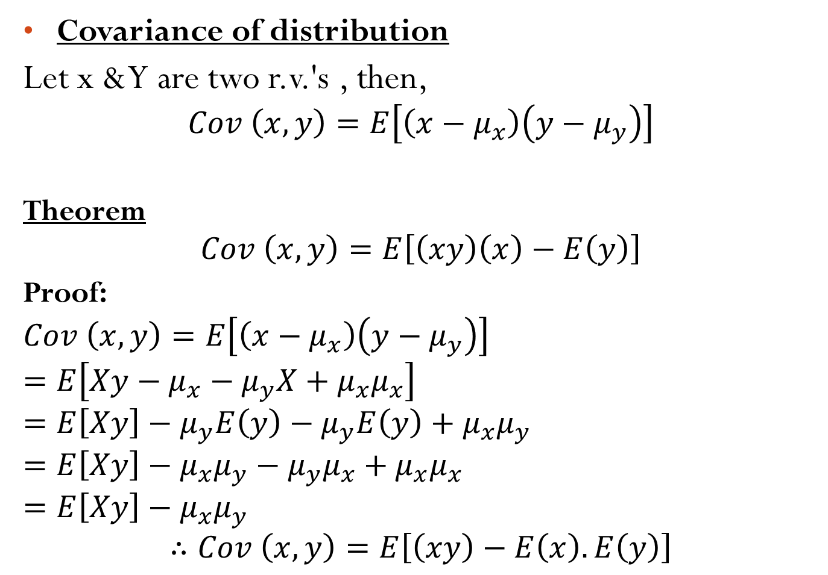
Covariance of distribution
Let x & Y are two r.v.'s , then,
$$Cov \left(x,y\right)=E\left[\left(x−μ_{x}\right)\left(y−μ_{y}\right)\right]$$
Theorem
$$Cov \left(x,y\right)=E\left[\left(xy\right)\left(x\right)−E\left(y\right)\right]$$
Proof:
$$Cov \left(x,y\right)=E\left[\left(x−μ_{x}\right)\left(y−μ_{y}\right)\right]$$
$$=E\left[Xy−μ_{x}−μ_{y}X+μ_{x}μ_{x}\right]$$
$$=E\left[Xy\right]−μ_{y}E\left(y\right)−μ_{y}E\left(y\right)+μ_{x}μ_{y}$$
$$=E\left[Xy\right]−μ_{x}μ_{y}−μ_{y}μ_{x}+μ_{x}μ_{x}$$
$$=E\left[Xy\right]−μ_{x}μ_{y}$$
$$∴Cov \left(x,y\right)=E\left[\left(xy\right)−E\left(x\right).E\left(y\right)\right]$$

Slide 3
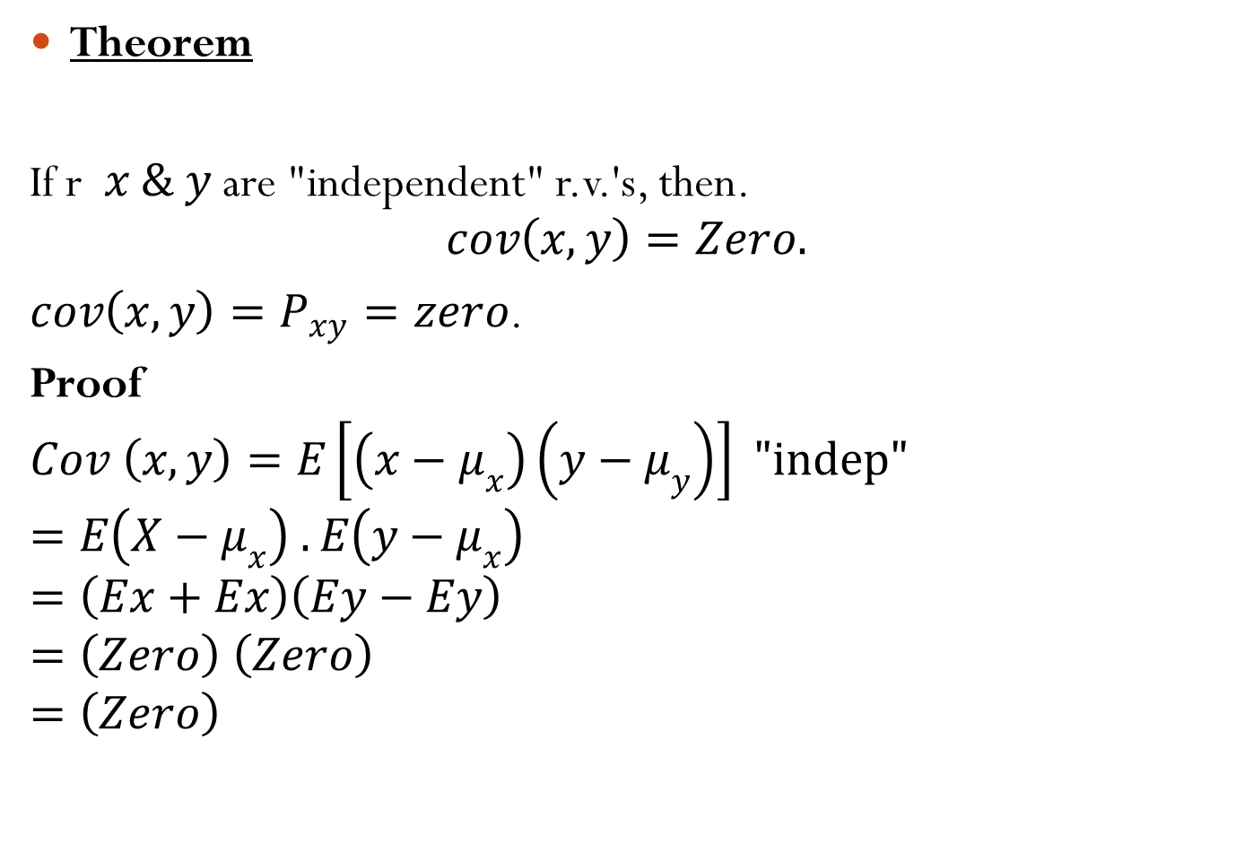
Theorem
If r$x \& y$ are "independent" r.v.'s, then.
$$cov\left(x,y\right)=Zero.$$
$cov\left(x,y\right)=P_{xy}=zero$.
Proof
$$Cov \left(x,y\right)=E\left[\left(x−μ_{x}\right)\left(y−μ_{y}\right)\right] "indep"$$
$$=E\left(X−μ_{x}\right) . E\left(y−μ_{x}\right)$$
$$=\left(Ex+Ex\right)\left(Ey−Ey\right)$$
$$=\left(Zero\right) \left(Zero\right)$$
$$=\left(Zero\right)$$

Slide 4
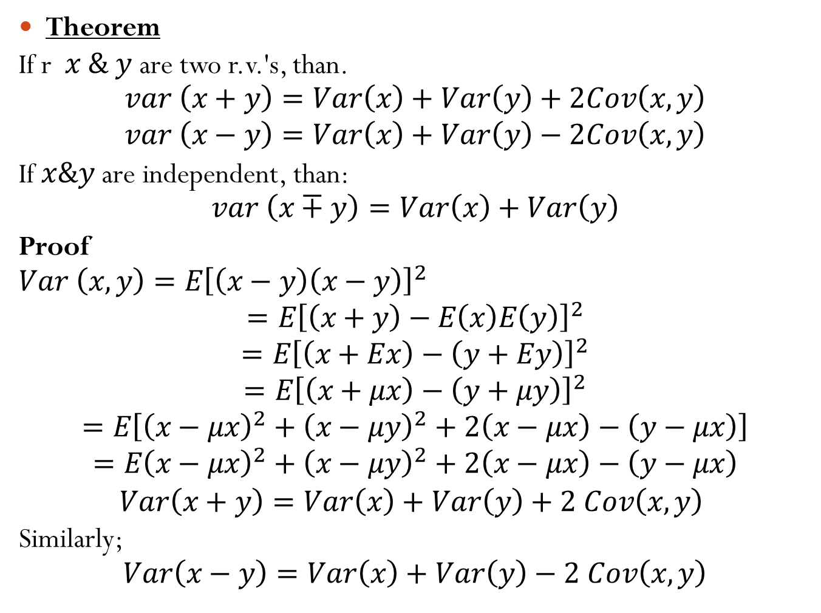
Theorem
If r$x \& y$ are two r.v.'s, than.
$$var \left(x+y\right)=Var\left(x\right)+Var\left(y\right)+2Cov\left(x,y\right)$$
$$var \left(x−y\right)=Var\left(x\right)+Var\left(y\right)−2Cov\left(x,y\right)$$
If $x\&y$ are independent, than:
$$var \left(x∓y\right)=Var\left(x\right)+Var\left(y\right)$$
Proof
$$Var \left(x,y\right)=E{\left[\left(x−y\right)\left(x−y\right)\right]}^{2}$$
$$=E{\left[\left(x+y\right)−E\left(x\right)E\left(y\right)\right]}^{2}$$
$$=E{\left[\left(x+Ex\right)−\left(y+Ey\right)\right]}^{2}$$
$$=E{\left[\left(x+μx\right)−\left(y+μy\right)\right]}^{2}$$
$$=E\left[{\left(x−μx\right)}^{2}+{\left(x−μy\right)}^{2}+2\left(x−μx\right)−\left(y−μx\right)\right]$$
$$=E{\left(x−μx\right)}^{2}+{\left(x−μy\right)}^{2}+2\left(x−μx\right)−\left(y−μx\right)$$
$Var\left(x+y\right)=Var\left(x\right)+Var\left(y\right)+2 Cov\left(x,y\right)$
Similarly;
$$Var\left(x−y\right)=Var\left(x\right)+Var\left(y\right)−2 Cov\left(x,y\right)$$

Slide 5
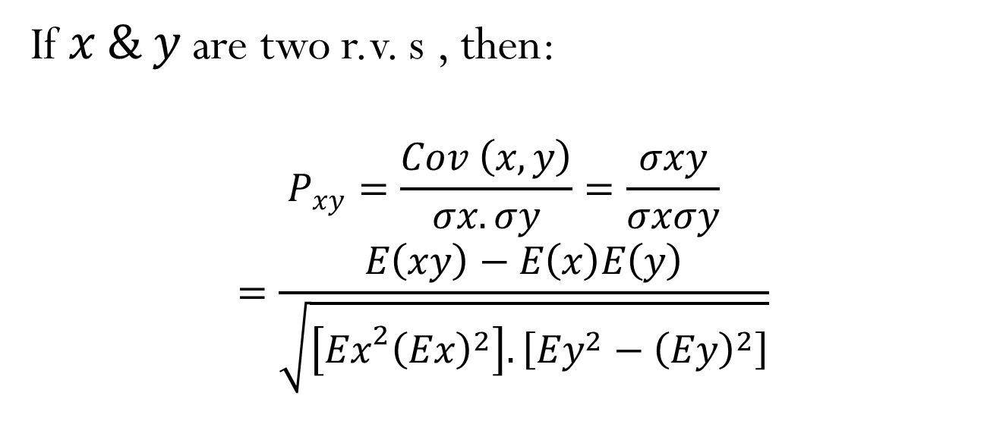
Correlation of distribution
If $x \& y$ are two r.v. s , then:
$$P_{xy}=\frac{Cov \left(x,y\right)}{σx.σy}=\frac{σxy}{σxσy}$$
$$=\frac{E\left(xy\right)−E\left(x\right)E\left(y\right)}{\sqrt{\left[{Ex}^{2}{\left(Ex\right)}^{2}\right]. \left[Ey^{2}−{\left(Ey\right)}^{2}\right]}}$$

