Slide 1
Lesson Eight
Distribution of Two Variables

Slide 2
Discrete Variables
Let $x_{1}\& x_{2}$ be two stochastic independent r.v.'s, and $f\left(x_{1},x_{2}\right)$ be the joint pf of them, and A be two dimensional set of points at which $f\left(x_{1},x_{2}\right)>0$.
Let $y_{1}=h_{1}\left(x_{1},x_{2}\right),{ y}_{2}=h_{2}\left(x_{1},x_{2}\right)$
Define a one – to- one transformation which maps A to $X_{1}, X_{2}$ onto the space B of $y_{1},y_{2}$.
The joint pmf of the two new random variables are:
$x_{1}=h_{2}^{−1}\left(y_{1},y_{2}\right),{ x}_{2}=h_{2}^{−1}\left(y_{1},y_{2}\right)$ and given by:
$g\left(y_{1},y_{2}\right)=$ $g\left(h_{1}^{−1}\left(y_{1},y_{2}\right), { h}_{2}^{−1}\left(y_{1},y_{2}\right)\right); { y}_{1},y_{2}∈B$
Where $x_{1} \& x_{2}$ are the single–valued inverse of $y_{1} \& y_{2}$ and from this jpmf We may obtain the margival pmf of $y_{1}$ by summing over $y_{2}$ or the marginal pmf of $y_{2}$ by summing over $y_{1}$.

Slide 3
Continuous Variables
Let $x_{1}$ and $x_{2}$ be two independent C.r.V.'s
With jpdf. $f\left(x_{1},x_{2}\right)$. Let A denotes the two dimensional set, ant let $y_{1}=h_{1}\left(x_{1},x_{2}\right)$ and $y_{2}=h_{2}\left(x_{1},x_{2}\right)$ be two r.v.'s defined on two dimensional set B.
The inverse function of $x_{1}$ and $x_{2}$ in terms of $y_{1}$and $y_{1}$ can be denoted by:
$$x_{1}=h_{1}^{−1}\left(y_{1},y_{2}\right),x_{2}=h_{2}^{−1}\left(y_{1},y_{2}\right)$$

Slide 4

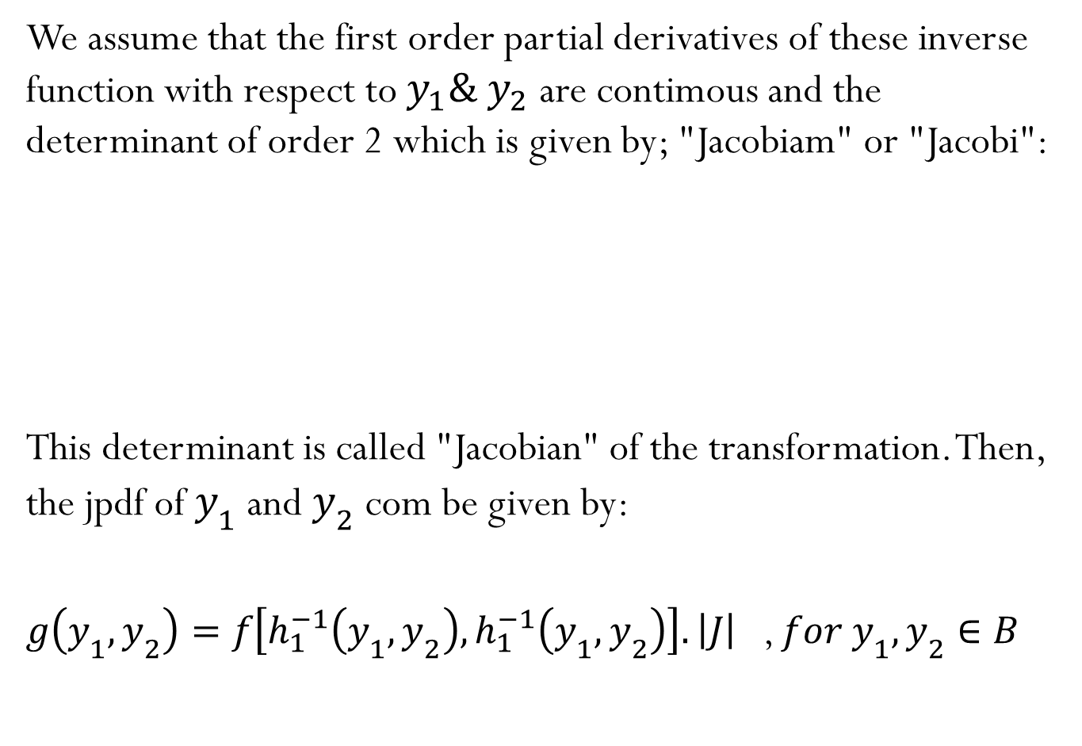
We assume that the first order partial derivatives of these inverse function with respect to $y_{1}\& y_{2}$ are contimous and the determinant of order 2 which is given by; "Jacobiam" or "Jacobi":
This determinant is called "Jacobian" of the transformation. Then, the jpdf of $y_{1}$ and $y_{2}$ com be given by:
$g\left(y_{1},y_{2}\right)=f\left[h_{1}^{−1}\left(y_{1},y_{2}\right),h_{1}^{−1}\left(y_{1},y_{2}\right)\right].\left|J\right|$ , $for y_{1},y_{2}∈B$
$$J=\frac{∂\left(x_{1},x_{2}\right)}{∂\left(y_{1},y_{2}\right)}=\left|\begin{matrix}\frac{∂x_{1}}{∂y_{1}} & \frac{∂x_{1}}{∂y_{2}} \\ \frac{∂x_{2}}{∂y_{1}} & \frac{∂x_{2}}{∂y_{2}}\end{matrix}\right|$$

