Slide 1
د. امتثال رشيد بجاي محاسبة كلفة 1 مرحلة ثالثة

Slide 2
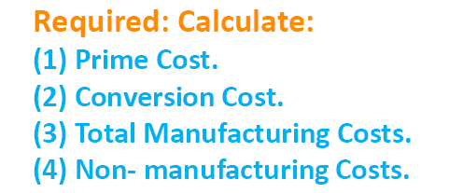

Slide 4
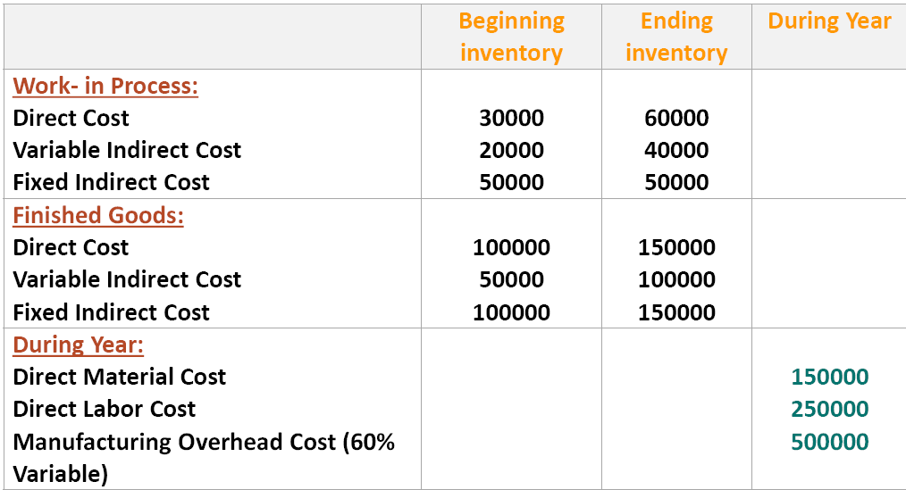

Slide 7
Ex 1 Flow of Inventor able Costs Ranks, Heaters S elected data for October 2016.
105000 $ | Direct materials inventory 10/1/2016
364000 $ | Direct materials purchased
385000 $ | Direct materials used
450000 $ | Total manufacturing overhead costs
265000 $ | Variable manufacturing overhead costs
1610000 $ | Total manufacturing costs incurred during October 2016
230000 $ | Work- in process inventory 10/1/2016
1660000 $ | Cost of good manufactured
130000 $ | Finished good inventory 10/1/2016
1770000 $ | Cost of good sold

Slide 8
Calculate the following Costs:
1. Direct materials inventory 10/31/2016.
2. Fixed manufacturing overhead costs.
3. Direct manufacturing labor Costs for October 2016.
4. Work- in process inventory 10/1/2016.
5. Cost of finished good available for sale in October 2016.
6. Finished good inventory 10/31/2016.

Slide 9
EX2 For the previous month (march 2016) Ron was able to piece together the following information : 240000 $ Direct materials purchased 70000 $ Work- in process inventory 3/1/2016 25000 $ Direct materials inventory 3/1/2016 230000 $ Finished good inventory 3/1/2016 660000 $ Conversion Cost 840000 $ Total manufacturing costs added during the period Direct materials used Cost of good manufactured 20 % Gross margin as a percentage of revenues 1037500 $ Revenues Calculate the Cost of: 1. Finished good inventory 3/31/2016. 2. Work- in process inventory 3/31/2016. 3. Direct materials inventory 3/31/2016.

Slide 10
EX3 Direct and absorption costing ,During the past year , Morgan Company produced 15000 units (100% of normal capacity) of a product and sold 120000 of these units production costs consisted of 300000$ direct materials ,375000 $ direct labor, 150000 $ variable factory overhead, and 187500 $ fixed factory overhead .
Required :
1) Using direct costing, Compute (a) the per unit cost of production and (b) the year- end inventory cost.
2) Using absorption costing, Compute (a) the per unit cost of production and (b) the year- end inventory cost.

Slide 11
EX4 Absorption and direct costing , N Company began its operations on January 1 , 19A and produces one product that sells for $7 Normal capacity is 100000 units per year with 100000 units produced and 80000 units sold in 19A , Manufacturing costs and marketing and administrative expenses were as follows :
item | Fixed costs | Variable costs
Materials | - | 1.50 per unit produced
Direct labor | - | 100 per unit produced
Factory overhead | 150000 $ | 0.50 per unit produced
marketing and administrative expenses | 80000 $ | 0.50 per unit sold
There were no variances form the standard variable costs, Any under – or over applied overhead is written off directly at year end as an adjustment to the cost of good sold .
Required:
1. In presenting inventory on the December 31,19A balance sheet ,Compute the unit – Cost under absorption costing.
2. Determine the 19A Operating income , using direct costing.

Slide 12
EX5 Income statements- absorption costing & direct costing ,The following data pertain to April
Beginning inventory | 0
Unit sold | 5000
Units produced | 8000
Sales price per unit | 24 $
Direct manufacturing cost per unit | 10
Fixed factory overhead- total | 28000
Fixed factory overhead- per unit | 3.50
Commercial expense (all fixed ) | 10000
Required:
Prepare an income statement using absorption costing.
Prepare an income statement using direct costing.
Provide computations explaining the difference in operating income between the two methods.

Slide 13
ECONOMIC Order Quantity كمية الطلب الاقتصادية EOQ
EX1 Fan Base (FB) operates a megastore featuring sport merchandise, it uses an EOQ decision model to make inventory decisions, it is now considering inventory decisions for its LOS Angeles Galaxy soccer jerseys product line .This is a highly popular item .Data for 2016 are as follows:

Slide 14
10000 | Expected annual demand for Galaxy jerseys
200 $ | Ordering cost per purchase order
7 $ jersey | Carrying cost per year
Each jersey costs FB 40 $ and sells for 80 $, the 7 $ Carrying cost per jersey per year comprises the required return on investment of 4.80 $ (12 x 40$ purr chase price ) plus 2.20 $ in relevant insurance , handling , and theft –related costs ,the purchasing lead time is 7 days .FB is open 365 days a year.
Required :
Calculate the EOQ.
Calculate the number of orders that will be placed each year.
Calculate the reorder point.

Slide 15
EX2 The Denim World sells fabric to a wide range of industrial and consumer users one of the products it carries is denim cloth, used in the manufacture of jeans and carrying bags, The supplier for the denim cloth pays all incoming freight , No incoming inspection of the denim is necessary because the supplier has a track record of delivering high- quality merchandise, the Denim World has collected the following information :

Slide 16
26400 yards Annual demand for denim cloth 165 $ Ordering cost per purchase order 20% of purchase costs Carrying cost per year None Safety- Stock requirements 9 $ per yard Cost of denim cloth
The purchasing lead time is 2 week .The Denim World is open 250 day a year
( 50 week for 5 days a week). Required :
Calculate the EOQ for denim cloth.
Calculate the number of orders that will be placed each year.
Calculate the reorder point for denim cloth.

Slide 17
1. Maximum Stock level 2. Minimum Stock level 3. Re-ordering level 4.Average Stock level.
Normal Consumption | 600 unit per week
Maximum Consumption | 840 unit per week
Minimum Consumption | 480 unit per week
Re-ordering quantity | 7200 unit
Re-ordering period | 10 to 15 week
Normal reorder period | 12 week

Slide 18
EX 4 The following information available in respect of a material X:
Re-ordering quantity | 1800 unit
Maximum Consumption | 450 unit per week
Minimum Consumption | 150 unit per week
Normal Consumption | 300 unit per week
Re-ordering period | 3 to 5 week
calculate the following: (a) Re-ordering level (b) Minimum Stock level
(c) Maximum Stock level.

Slide 19
EX 5 Tow Components P,Q are used as follows, Normal usage 1000 unit per week each , Re-ordering quantity P 20000 ; Q 8000 , Re-ordering period P 4 to 6 week ; Q 2 to 4 ; Minimum usage 2000 unit per week ; each Maximum usage 3000 unit per week each.
You are required to calculate the following each of the Components:
1. Minimum Stock level.
2. Maximum Stock level.
3. Average Stock level.
4. Re-ordering level.
EX 6 From the following information for last twelve month, compute the
(1) Re-order level.
(2) Minimum level.
(3) Maximum level.
(4) Average Stock level for the Components of X and Y

Slide 20
Components
item | X | Y
Maximum Components in a month | 3000 | 3000
Minimum Components in a month | 2000 | 2000
Average Components in a month | 1000 | 1000
Re-order period in a month | 8 to 12 | 4 to 8
Re-order quantity in units | 8000 | 12000

