Slide 1
Changes in Ownership Interest

Slide 2
Learning Objectives
أهداف الفصل التعليمية
تحديد أنواع المعالجات في تغير حقوق ملكية الشركة القابضة في التابعة .
وصف المعالجات اللازمة عند اكتساب الشركة القابضة اسهم في الشركة التابعة من خلال عمليات شراء متعددة في السوق المفتوح ( خطوات الاكتساب) .
تفسير كيفية ابلاغ الشركة القابضة عن الفرق بين سعر البيع والقيمة الدفترية للأسهم التي تم بيعها لاحقاً بعد الاكتساب
احتساب الحقوق المسيطر عليها في صافي الدخل بعد بيع الشركة القابضة بعض اسهم الشركة التابعة.
وصف التأثير على عمليات الاستبعاد عندما تصدر الشركة التابعة اسهم جديدة بالكامل الى الشركة القابضة .
وصف التأثير على حساب الاستثمارات في عندما تصدر الشركة التابعة اسهم جديدة ، فأما ان يتم شراء الاسهم المقيمة الجديدة من قبل الشركة القابضة و حملة اقلية الاسهم ، او يتم شرائها بالكامل من قبل حملة اقلية الاسهم .

Slide 3
Changes in Ownership Interest
1- يمكن للشركة القابضة زيادة حصة او نسبة ملكيتها بشكب فعال في الشركة التابعة من خلال :
* شراء اسهم اضافية من التابعة مباشرة من طرف ثالث
* شراء التابعة اسهمها من طرف ثالث
2- يمكن للشركة القابضة تخفيض حصة او نسبة ملكيتها بشكل فعال في الشركة التابعة من خلال :
* بيع بعض اسهم التابعة مباشرة لطرف ثالث
* بيع اسهم اضافية تمتلكها التابعة (بما في ذلك اسهم الخزانة )لطرف ثالث
LO 1 Changes in ownership.

Slide 4
Changes in Ownership Interest
: GAAP بموجب (ASC Topics 805 and 810)
عمليات الاكتساب تتم وفق مراحل او بالبيع الجزئي :
*القياس والاعتراف بالاصول والالتزامات القابلة للتحديد بنسبة 100% من قيمتها العادلة بتأريخ الاكتساب او السيطرة .
* الاعتراف بشهرة المحل المكتسبة ( وليس فقط حصتة الشركة القابضة) وتقاس من خلال الفرق بين القيمة العادلة للاكتساب و القيمة العادلة لصافي الاصول القابلة للتحديد .
(Continued)
LO 1 Changes in ownership.

Slide 5
Changes in Ownership Interest
: Current GAAP
عمليات الاكتساب التي تتم وفق مراحل او البيع الجزئي :
ينبغي اعادة قياس اي حقوق غير خاضعة للسيطرة بالقيمة العادلة مع الاعتراف بالتسويات الناتجة في الدخل .
بعد تحقيق السيطرة تظهر التعديلات اللاحقة بسبب زيادة الملكية بشكل علاوة رأس المال Additional Contributed Capital وليس دخل .
اذا فقدت الشركة القابضة السيطرة ينبغي اعادة قياس الاستثمار بالقيمة العادلة مع اجراء تعديلات في صافي الدخل
LO 1 Changes in ownership.

Slide 6
Parent Acquires Subsidiary Stock Through Several Open-Market Purchases—Cost Method
Current GAAP (ASC paragraph 805-10-25-9)
ينبغي اعادة قياس الحقوق غير الخاضعة للسيطرة بالقيمة العادلة عند تحقق السيطرة ، واثبات وتعديل التغيرات الناتججة في صافي الدخل .
اذا فقدت الشركة القابضة السيطرة ولكنها ماتزال تحتفظ بالحقوق غير الخاضعة للسيطرة فيجب اعادة قياس الحقوق غير الخاضة للسيطرة المحتفظ بها بالقيمة العادلة في تأريخ فقدان السيطرة وتعكس هذه التعديلات في كشف الدخل .
LO 2 Multiple open market purchases.

Slide 7
Several Open-Market Purchases—Cost Method
Illustration: S Company had 10,000 shares of $10 par value common stock outstanding and retained earnings as follows:
January 1, 2013 (1st stock purchase) $ 40,000
January 1, 2015 (control achieved) 120,000
S Company Retained Earnings
P Co. purchased S Co. common stock on the open market for cash:
January 1, 2013 1,500 shares (15% of 10,000 shares) $ 24,000
January 1, 2015 7,500 shares (75% of 10,000 shares) 187,500
Total 9,000 shares (90% of 10,000 shares) $211,500
LO 2 Multiple open market purchases.

Slide 8
Several Open-Market Purchases—Cost Method
Thus on P’s books, the following entries are made:
January 1, 2013
January 1, 2015
Assumptions:
Any difference between implied and book values of the purchases relates solely to goodwill and is, therefore, not subject to amortization or depreciation but is reviewed periodically for impairment.
S Company distributes no dividends during the periods under consideration.
Solution on note page
LO 2 Multiple open market purchases.

Slide 9
Several Open-Market Purchases—Cost Method
Calculation of IMPLIED Value of S Company:
LO 2 Multiple open market purchases.

Slide 10
Several Open-Market Purchases—Cost Method
Because P Company has owned a percentage of S Company (15%) since January 1, 2013, an entry is needed on P’s books to revalue the 1,500 shares purchased in 2013 to their fair value as of the date of control ( January 1, 2015).
Initial purchase price (1,500 shares at $16/share) $24,000
Change in retained earnings of S since acquisition 15%:
[.15 x ($120,000 - $40,000)] 12,000
Carrying value (implied) of initial investment $36,000
Thus the gain on revaluation of the initial shares is computed as:
Implied value ($25/share 1,500) $37,500
Implied carrying value of initial shares 36,000
Revaluation gain $ 1,500
LO 2 Multiple open market purchases.

Slide 11
Several Open-Market Purchases—Cost Method
The following entry is made on P company books.
Investment in S Company 1,500
Gain on revaluation 1,500
A workpaper entry is needed on December 31, 2015, to convert to equity (establish reciprocity) from 2013 to 1/1/15.
Investment in S Company 12,000
1/1 Retained Earnings—P Company 12,000
[.15 x ($120,000 - $40,000) change in retained earnings from 1/1/13 to 1/1/15]
LO 2 Multiple open market purchases.

Slide 12
Several Open-Market Purchases—Cost Method
On the workpaper, the investment is eliminated by the following entry:
Common Stock—S Company 100,000
1/1 Retained Earnings—S Company 120,000
Difference between Implied and Book Value 30,000
Investment in S Company ($187,500 + $37,500) 225,000
Noncontrolling Interest in Equity 25,000
LO 2 Multiple open market purchases.

Slide 13
Several Open-Market Purchases—Cost Method
مقارنة مع IFRS
معيار IFRS3 اندماجات الاعمال ، يقدم توجيهات لخطوات الاكتساب بموجب المعايير الدولية .
بموجب معيار IFRS3 ، يتم تعديل جميع حقوق الملكية السابقة بالقيمة العادلة مع الاعتراف بأي مكسب او خسارة في الدخل ، وهذا مشابه للقواعد الصادرة من قبل FASB .
LO 2 Multiple open market purchases.

Slide 14
Sell Investment on Open-Market—Cost Method
الاحتفاظ بالسيطرة
تعتمد المعالجات على اذ تم بيع جزء من استثمارات القابضة في التابعة على اذا كان البيع يؤدي الى فقدان السيطرة الفعالة على الشركة التابعة او عدم فقدانها
اذا تم الاحتفاظ بالسيطرة ، لا يتم الاعتراف بأي مكسب او خسارة في صافي الدخل ، ويتم اجراء تعديلات على حساب علاوة رأس المال additional contributed capital للحقوق المسيطرة .
فقدان السيطرة يتم تعديل الحقوق بأكملها بالقيمة العادلة ، وتسجيل المكاسب والخسائر في الدخل على جميع الاسهم المكتسبة قبل البيع .
LO 3 Parent sells shares subsequent to acquisition

Slide 15
Sell Investment on Open-Market—Cost Method
Illustration: P Company owns 9,000 shares of S Company that were revalued to $25 a share on the date of acquisition, or $225,000. Assume that P Company sold 1,800 shares of the 9,000 shares of S Company stock on July 1, 2015, for $84,600 ($47/share). The cost of the 1,800 shares sold equals $45,000 (or 20% of $225,000). After the sale, P Company retains control with a 72% ((9,000 x 80%)/10,000) interest. Note that the 1,800 shares sold represent 18% of total S Company shares.
LO 3 Parent sells shares subsequent to acquisition

Slide 16
Sell Investment on Open-Market—Cost Method
Illustration: To record the sale of the shares, P Company makes the following entry in its books on July 1, 2015.
Cash 84,600
Investment in S Company (20% x $225,000) 45,000
Additional Contributed Capital—P Company 39,600
After this entry, the balance in the investment in S Company account on P Company books will be $168,000 ($24,000 + $187,500 + $1,500 -$45,000).
LO 3 Parent sells shares subsequent to acquisition

Slide 17
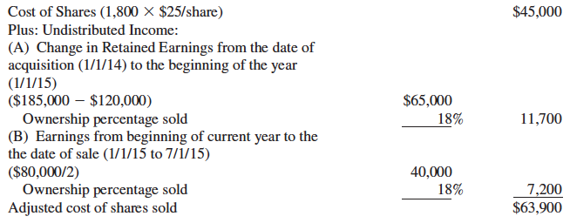
Sell Investment on Open-Market—Cost Method
From a consolidated standpoint, the cost of the shares sold ($45,000) needs to be adjusted for 18% of the undistributed earnings since the date of acquisition.
LO 3 Parent sells shares subsequent to acquisition

Slide 18
Sell Investment on Open-Market—Cost Method
The correct consolidated amount of additional contributed capital on is:
An adjustment is needed on the workpapers to reduce additional contributed capital:
LO 3 Parent sells shares subsequent to acquisition

Slide 19
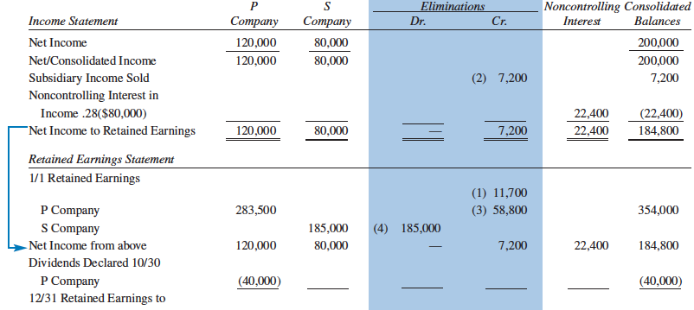

Slide 20
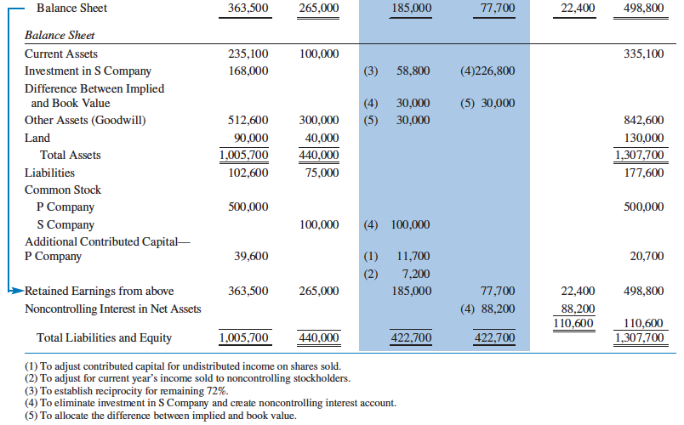

Slide 21
Equity Method—Purchase and Sale of Stock
عندما يتم اجراء اكثر من عملية شراء قبل امتلاك السيطرة ، يتم تحديد تأريخ الاكتساب على انه تأريخ تحقيق السيطرة .
يوضح المثال الاتي الاجراءات المتبعة لشراء وبيع الاسهم التابعة في السوق المفتوح بموجب طريقة الملكية :
LO 3 Parent sells shares subsequent to acquisition

Slide 22
Equity Method—Purchase and Sale of Stock
Illustration: S Company had 10,000 shares of $10 par value common stock outstanding during 2012–2015 and retained earnings as follows:
January 1, 2012 $ 40,000
January 1, 2014 120,000
January 1, 2015 185,000
December 31, 2015 265,000
S Company Retained Earnings
P Co. purchased S Co. common stock on the open market for cash:
January 1, 2012 1,500 shares (15%) * $ 24,000
January 1, 2014 7,500 shares (75%) * 187,500
Total 9,000 shares (90%) * $211,500
* of 10,000 shares
LO 3 Parent sells shares subsequent to acquisition

Slide 23
Equity Method—Purchase and Sale of Stock
Assumptions:
Any difference between implied and book value of net assets acquired relates to goodwill.
S Company distributed no dividends during the periods under consideration. Since no dividends were declared, the change in retained earnings represents the net income for that year.
P Company sold 1,800 shares of S Company stock on July 1, 2015, for $84,600.
P Company’s Books:
1/1/12 1/1/14
Investment in S 24,000 Investment in S 187,500
Cash 24,000 Cash 187,500
LO 3 Parent sells shares subsequent to acquisition

Slide 24
Equity Method—Purchase and Sale of Stock
Since P Company now has a 90% interest in S Company and intends to apply the equity method, the investment account must be restated to recognize P Company’s share (15%) of the increase in S Company’s retained earnings from January 1, 2012, to January 1, 2014.
Investment in S Company 12,000
1/1 Retained Earnings—P Company 12,000
[.15 x ($120,000 x $40,000) or the change in retained earnings from 1/1/12 to 1/1/14].
LO 3 Parent sells shares subsequent to acquisition

Slide 25
Equity Method—Purchase and Sale of Stock
To adjust the investment to fair value as of the date of acquisition, the gain on revaluation of the initial shares is computed as:
P Company’s Books
Investment in S Company 1,500
Gain on revaluation 1,500
LO 3 Parent sells shares subsequent to acquisition

Slide 26
Equity Method—Purchase and Sale of Stock
P Company will recognize its share of S Company income for 2014 as follows:
Investment in S Company 58,500
Equity in Subsidiary Income 58,500
[90% x ($185,000 - $120,000)]
LO 3 Parent sells shares subsequent to acquisition

Slide 27
Equity Method—Purchase and Sale of Stock
Assuming P Company received a six month interim income statement from S Company reporting $40,000 of net income, the following entry will be made by P Company on June 30, 2015.
Investment in S Company 36,000
Equity in Subsidiary Income 36,000
(90% x $40,000)
Investment in S Company
1/1/12 Purchase (15%) $ 24,000
1/1/14 Adjustment of 15% to fair value 1,500
1/1/14 Purchase (75%) 187,500
1/1/14 Adjustment 12,000
12/31/14 Subsidiary Income 58,500
6/30/15 Subsidiary Income 36,000
Balance $319,500

Slide 28
Equity Method—Purchase and Sale of Stock
To record the sale of the S Company shares on July 1, 2015, P Company will make the following entry (recall that P Company is selling 20% of its shares):
Cash 84,600
Investment in S Company* 63,900
Additional contributed capital 20,700
* $63,900 = 20% of $319,500, the carrying value of the investment.
LO 3 Parent sells shares subsequent to acquisition

Slide 29
Equity Method—Purchase and Sale of Stock
After the sale of the 1,800 shares, P Company holds a 72% interest in S Company. For the second six months of 2015 (and for subsequent periods), P Company will recognize 72% of the reported income and dividends received from S Company. The December 31, 2015, book entry by P Company is:
Investment in S Company 28,800
Equity in Subsidiary Income 28,800
($40,000 X 72%)
LO 3 Parent sells shares subsequent to acquisition

Slide 30
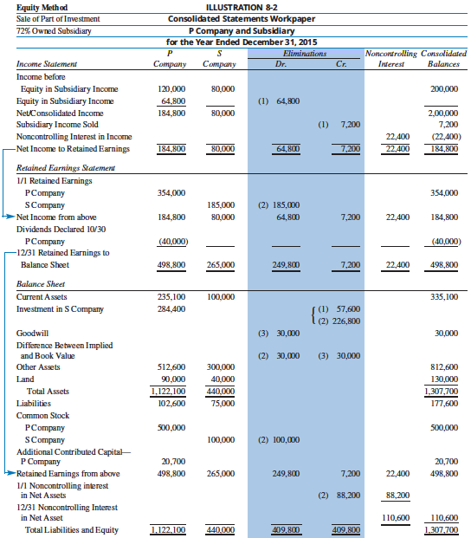

Slide 31
Sell Investment on Open-Market—Cost Method
فقدان السيطرة
تعتمد المعالجات على اذ تم بيع جزء من استثمارات القابضة في التابعة على اذا كان البيع يؤدي الى فقدان السيطرة الفعالة على الشركة التابعة او عدم فقدانها
اذا تم الاحتفاظ بالسيطرة ، لا يتم الاعتراف بأي مكسب او خسارة في صافي الدخل ، ويتم اجراء تعديلات على حساب علاوة رأس المال additional contributed capital للحقوق المسيطرة .
فقدان السيطرة يتم تعديل الحقوق بأكملها بالقيمة العادلة ، وتسجيل المكاسب والخسائر في الدخل على جميع الاسهم المكتسبة قبل البيع .
LO 3 Parent sells shares subsequent to acquisition

Slide 32
Sell Investment on Open-Market—Cost Method
الغاء توحيد حسابات الشركة القابضة من خلال الاعتراف بالمكاسب او الخسائر في صافي الدخل المتعلق بالقابضة ، وقياس الفرق بين Carrying value للشركة التابعة ومجوع ما يأتي :
القيمة العادلة لاعتبارات التقييم
القيمة العادلة للحقوق غير المسيطر عليها المحتفظ بها ( في تأريخ الغاء التوحيد)
Carrying value لحملة الاسهم السابقين ( في تأريخ الغاء التوحيد) ويشمل هذا ايضاً الدخل الشامل المتراكم المرتبط بالحقوق غير الخاضعة للسيطرة .
LO 3 Parent sells shares subsequent to acquisition

Slide 33
Sell Investment on Open-Market—Cost Method
Illustration: Suppose P Company owns 9,000 shares of S Company (90% of S Company) that were acquired at $25 a share (or $225,000) on January 1, 2014. During 2014, S Company reported $60,000 of income and did not pay any dividends.
Investment (9,000 shares x $25) 225,000
Cash 225,000
LO 3 Parent sells shares subsequent to acquisition

Slide 34
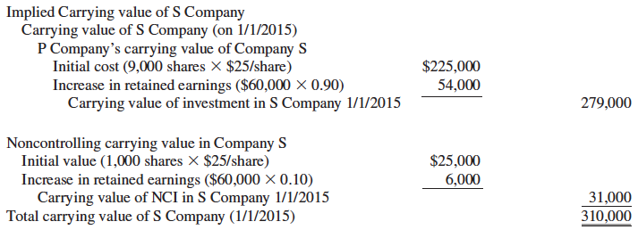
Sell Investment on Open-Market—Cost Method
On January 1, 2015, P Company sold two-thirds of its investment (6,000 shares) of S Company stock, for $180,000 ($30/share). After the sale, P Company has lost control and now only maintains a 30% ((9,000 - 6,000)/10,000) interest. The carrying value of S company, on January 1, 2015, is computed as follows:

Slide 35
Sell Investment on Open-Market—Cost Method
The gain or loss in net income attributable to P Company is computed as follows:
LO 3 Parent sells shares subsequent to acquisition

Slide 36
Sell Investment on Open-Market—Cost Method
To record the sale of the shares, P Company makes the following entry in its books on January 1, 2014.
LO 3 Parent sells shares subsequent to acquisition

Slide 37
Sell Investment on Open-Market—Cost Method
Because P Company now holds a 30% (not controlling) interest in S Company, the investment must be carried on the books using the equity method. Thus, the investment account must be adjusted for previous earnings of S Company (i.e., the reciprocity entry usually made on the consolidated workpaper).
Investment in S Company (60,000 x .90) 54,000
1/1 Retained Earnings-P Company 54,000
After this entry, the balance in the Investment in S Company account on P Company books will equal its fair value of $90,000. Consolidated financial statements will no longer be required because P Company has lost control.
LO 3 Parent sells shares subsequent to acquisition

Slide 38
Subsidiary Issues Stock
اصدار اسهم اضافية من قبل الشركة التابعة
نفترض ان الشركة القابضة تمتلك السيطرة الفعالة على الشركة التابعة
يمكن شراء الاسهم المصدرة حديثاً
شراء الاسهم بالكامل من قبل الشركة القابضة
شراءها بشكل جزئي من قبل الشركة القابضة وحملة الاسهم غير المسيطرين
شراءها بشكل كامل من قبل حملة الاسهم غير المسيطرين
LO 5 Subsidiary issues new shares entirely to parent

Slide 39
Subsidiary Issues Stock
New Shares Issued above Existing Carrying Value per Share
Illustration: P Company purchased 14,000 shares (70%) of S Company’s $10 par value common stock on January 1, 2008, for $210,000, which included a $20,000 excess of implied over book value; the excess cost was assigned to land. S Company’s retained earnings on January 1, 2008, were $50,000.
LO 5 Issue of new shares entirely to the parent.

Slide 40
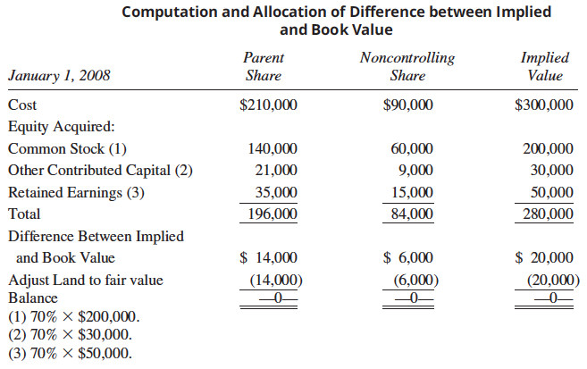
Subsidiary Issues Stock
LO 5 Issue of new shares entirely to the parent.

Slide 41
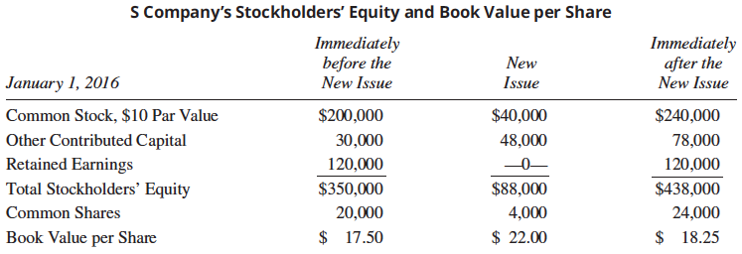
Subsidiary Issues Stock
On January 1, 2016, P Company purchased 4,000 additional shares of S Company stock directly from S Company at its current market price of $22 per share ($88,000). This price is greater than the existing book value per share of S Company. Noncontrolling stockholders elected not to participate in the new issue. S Company’s stockholders equity on January 1, 2016, was:

Slide 42
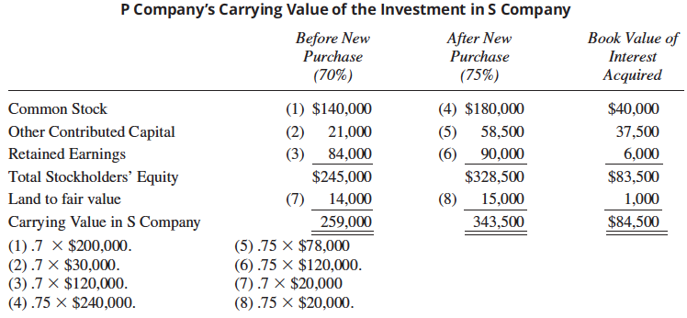
Subsidiary Issues Stock
LO 5 Issue of new shares entirely to the parent.

Slide 43
Subsidiary Issues Stock
Essentially, because the controlling stockholders paid more than the existing carrying value per share, the noncontrolling stockholders’ carrying value must increase.
LO 5 Issue of new shares entirely to the parent.

Slide 44
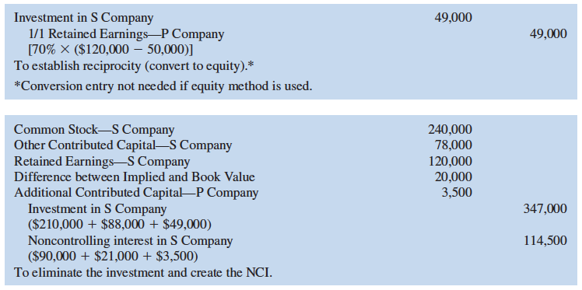
Subsidiary Issues Stock
If a workpaper were prepared immediately after the purchase of the new shares, the workpaper entries to establish reciprocity (convert to equity) and eliminate the investment account would be:

Slide 45
Subsidiary Issues Stock
New Shares Issued at or below the Existing Carrying Value per Share
Illustration: The shares are issued at their book value of $17.50 per share (or $70,000), the computation is as follows:
LO 5 New shares issued to the parent.

Slide 46
Subsidiary Issues Stock
Although the noncontrolling stockholders’ percentage of ownership decreases from 30% to 25%, their share of the net assets of S Company decreased only by the land value transferred, as shown here:
LO 5 New shares issued to the parent.

Slide 47
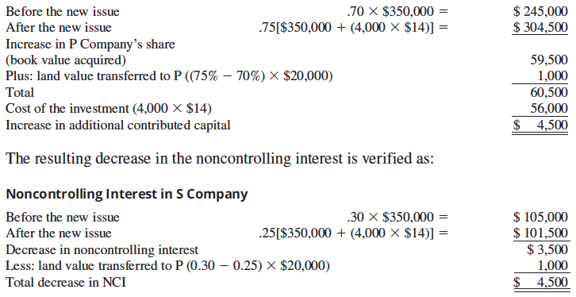
Subsidiary Issues Stock
Assume the new shares were issued at $14 per share (or $56,000). The excess of book value over cost is computed as follows:

Slide 48
Subsidiary Issues Stock
In this case, the $4,500 excess of book value over cost is treated as an increase
in the additional contributed capital of the parent.
Journal entry by P Company to record the purchase of the new shares is:
P Company’s Books
Investment in S company 56,000
Cash 56,000
LO 5 New shares issued to the parent.

Slide 49
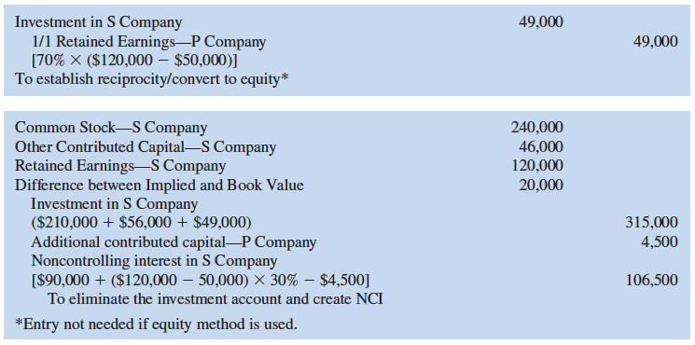
Subsidiary Issues Stock
Workpaper entries:
LO 5 New shares issued to the parent.

Slide 50
Subsidiary Issues Stock
تقييم شراء اسهم جديدة من قبل الشركة القابضة وحملة الاسهم غير المسيطرين
اذا اختار حملة الاسهم غير المسيطرين ممارسة حقوقهم ، فأن نسبة الاسهم المملوكة من قبل الشركة القابضة وحملة الاسهم غير المسيطرين بعد اصدار الاسهم الجديدة ستكون هي نفس الحقوق قبل اصدار الاسهم الجديد .
القيمة الدفترية للحقوق المكتسبة تساوي تكلفة اسهم الشركة القابضة وليس هنالك حاجة لتعديل حساب علاوة رأس المال additional contributed capital للشركة القابضة .
LO 6 New subsidiary shares purchased ratably by the parent and noncontrolling shareholders.

Slide 51
Subsidiary Issues Stock
شراء اسهم جديدة بالكامل من قبل حملة الاسهم غير المسيطرين
مادام عدد الاسهم المصدرة الجديدة ليس كبير لدرجة ان يخفض من نسبة ملكية الشركة القابضة واقل من النسبة اللازمة للسيطرة .يمكن توفير تمويل جديد والاحتفاظ بالسيطرة
ان اصدار اسهم جديدة لحملة الحقوق غير المسيطرة يخفض من نسبة ملكية الشركة القابضة .
الجوهر الاقتصادي لهذه العملية هو بيع الحقوق من قبل الشركة القابضة .
LO 6 New subsidiary shares purchased by noncontrolling shareholders.

Slide 52
IFRS and Step Acquisitions
بموجب IFRS
يتوفر خيار لقياس الحقوق غير الخاضعة للسيطرة
النسبة الجديدة لحقوقهم في الاصول القابلة للتحديد للشركة المكتسبة او
القيمة العادلة (مشابة U.S GAAP )
التغير في السيطرة يعد حدث ذو تأثير اقتصادي
يتم تطبيق محاسبة الاكتساب فقط في تأريخ تحقيق السيطرة
LO 6 Noncontrolling shareholders acquire new shares issued by subsidiary

