Slide 1
Jidhe alnakhla Stadium
Jidhe alnakhla Stadium Officially, Basra International Stadium is a stadium for football located in Basra Sports City in Iraq .Basra Nicknamed In the capital economiec For Iraq Which second Larger city in Iraq, it first city verification building stadium new arousing To admire.that size this Pitch And its standards Amazing Sends Signal Strong to that Iraq Back To appear Once Other on a map Sports Globalism

Slide 2
The stadium's design was inspired by the trunk of the palm tree, which the Iraqi city of Basra is famous for growing Construction began on July 15, 2009 and the city was opened on October 12, 2013. The construction cost amounted to 550 million US dollars. The city consists of a main stadium with a capacity of 65,000 spectators (Jidhe alnakhla Stadium), a secondary stadium with a capacity of 20,000 spectators (Basra Stadium), and four secondary stadiums for training

Slide 3
design and Building Basra Stadium?
Two American companies designed the Basra Sports City: Architectural 360 and Newport Global, while the latter managed the project, with Thornton Tomasetti Structural Engineering Company under taking the construction of the project. Abdullah Awaiz Al-Jubouri Company was the main contractor for the project in addition to its responsibility for the construction of the project. Service engineering.

Slide 4
Extensions in the Jidhe alnakhla stadium
.Five stadiums, one of which can accommodate about10.000 ten .thousand spectators. While the remaining four stadiums are designated for training.
.It also has a polo field and tennis courts.
.Olympic-standard swimming pool.
.Eight residential complexes.
.And 5-star hotels.
.Youth village.
.Hospital and ambulance unit.
.Shopping centers.
.A parking lot that can accommodate about 10,000 ten thousand cars.
The tower's height is estimated at about 150 metres

Slide 5
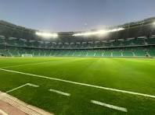
Basra stadium classification
Globally, Basra International Stadium is ranked No. 25 in the world in terms of capacity and number of seats in it, while it is ranked first among Iraqi stadiums in terms of the precision and beauty of construction, area and number of seats available in it as well. It also comes in an advanced rank among stadiums. Football in the Gulf region and the Arab world.

Slide 6
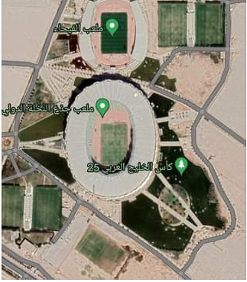
Information about the stadium
Ownership of the Jidhe alnakhla Stadium belongs to the Ministry of Youth and Sports in the State of Iraq.
The stadium's full capacity is estimated at approximately 65,227 thousand seats.
One of the wonderful views of the Jidhe alnakhla Stadium and the Sports City, taken by satellite, is that together they form the map of Iraq..
The Jidhe alnakhla Stadium has 18 external gates, which are the gates of the Sports City. Each of these gates was named after an Iraqi governorate..
The area of ​​Basra International Stadium is about 600 dunams.
Especially since the floor of the Jidhe alnakhla Stadium is made of natural grass.

Slide 7
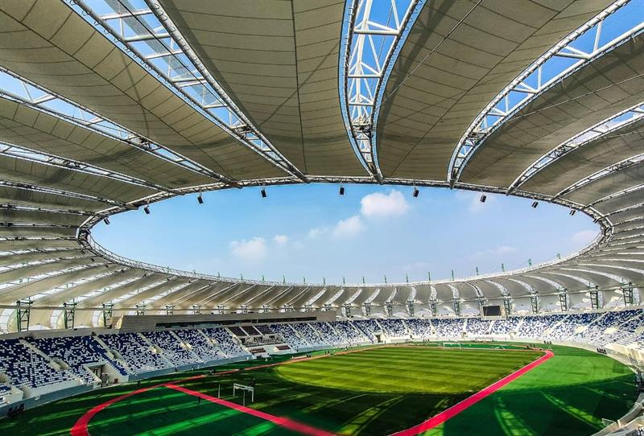
The grass field hosted 3 friendly matches
In June 1 2017 The first international match took place on the field The Iraqi national team And the Jordanian national teamThe match ended with Iraq's victory with a single goal scored by the player Alaa Abdel Zahra.
And inSeptember 9 2017 A match took place on the field between the Iraqi Stars and the World Stars, and the match ended with the World Stars winning by 5 goals, compared to 4 goals for the Iraqi Stars.

Slide 8
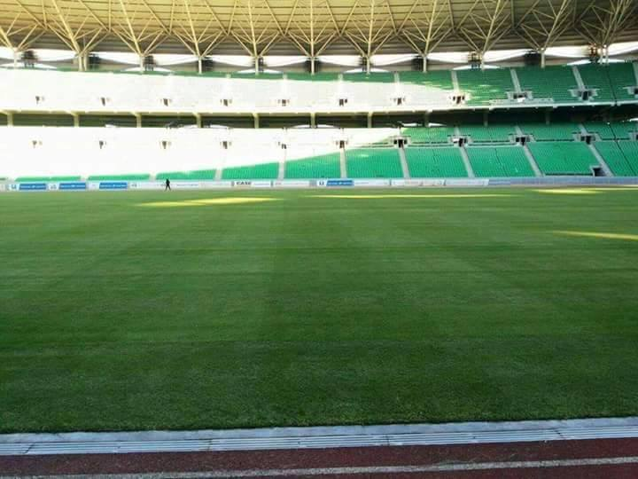
Champion ship Arabian Gulf Cup 25
In this stadium, championship matches were held Arabian Gulf Cup 25Which was held in January 2023 in Basra
On January 19, 2023 It was erected match To determine the winner of a tournamentGulf 25 I gathered the teamThe IraqiIn the national teamOmani.The Iraqi team won by three goals to two. Host Iraq won its fourth title in the tournament after an exciting match.

